Slide 1
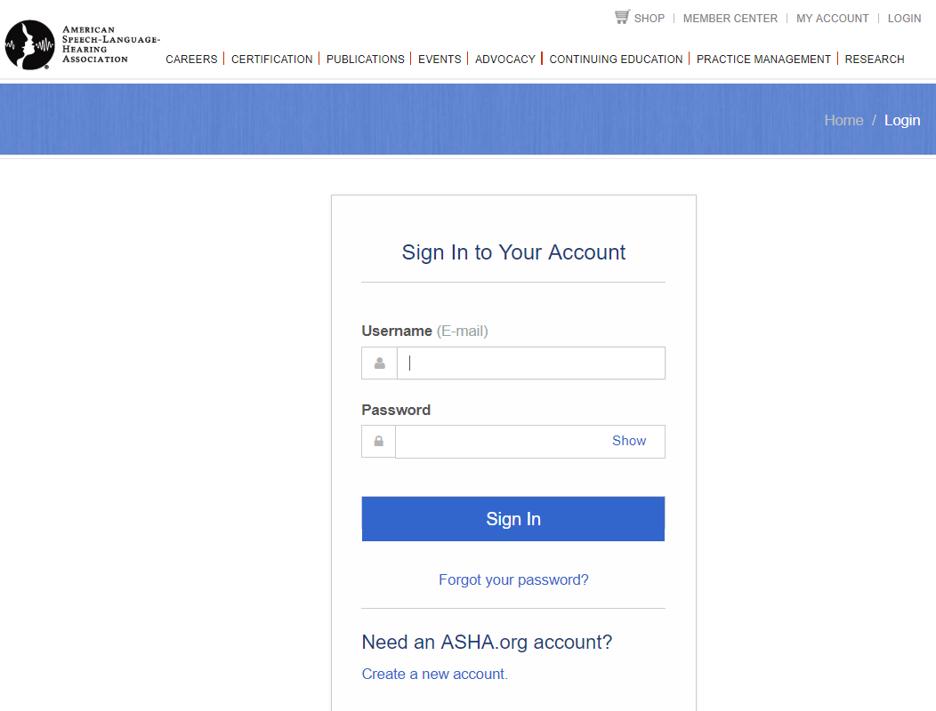
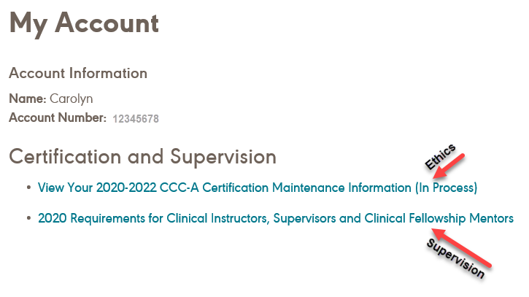
2020 Supervision Req
Login to your ASHA account
If you don’t have the 2nd hyperlink you have met the requirement

Slide 2
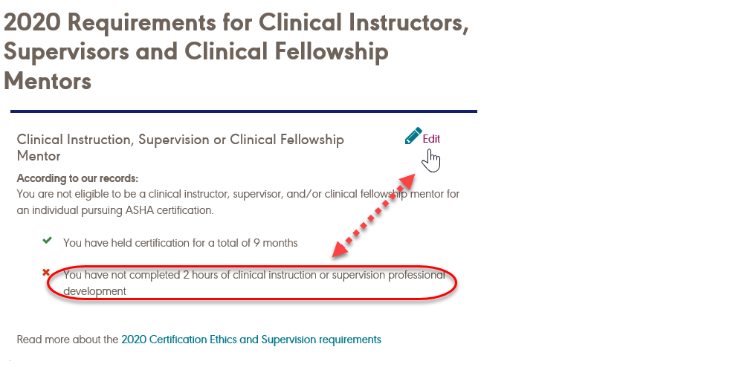
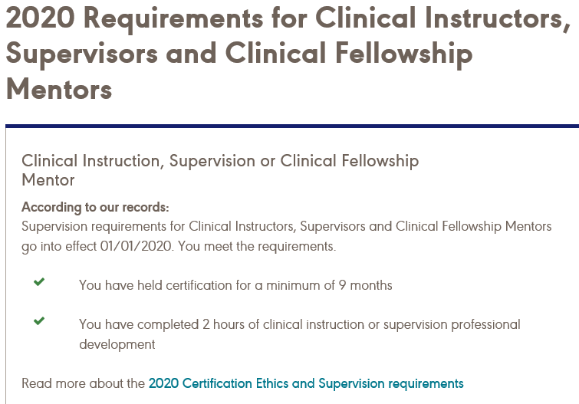
2020 Supervision Requirements

Slide 3
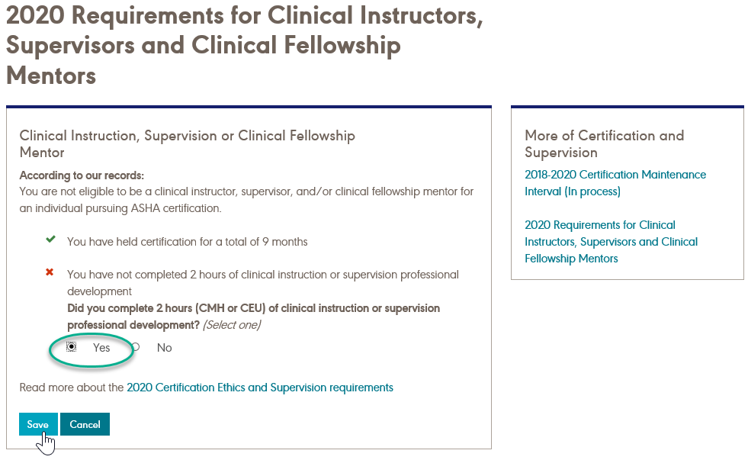
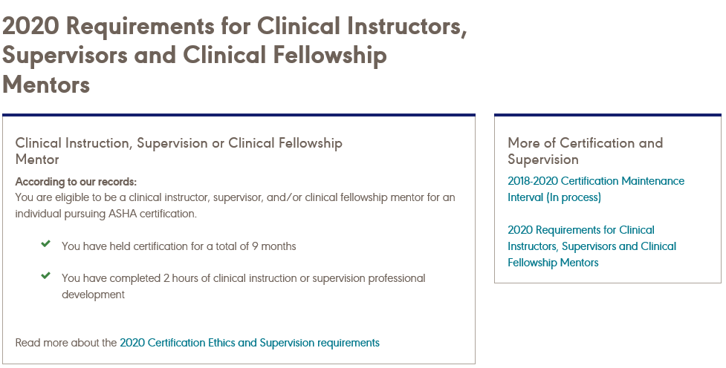
2020 Supervision
Cont’d.

Slide 4
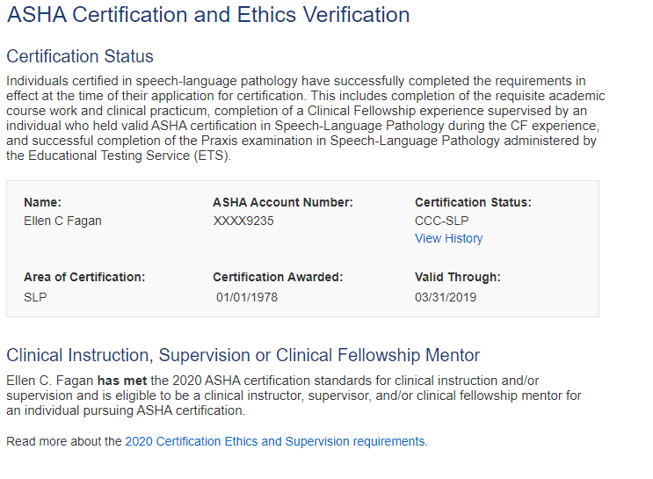
2020 Supervision Requirements

