Slide 1
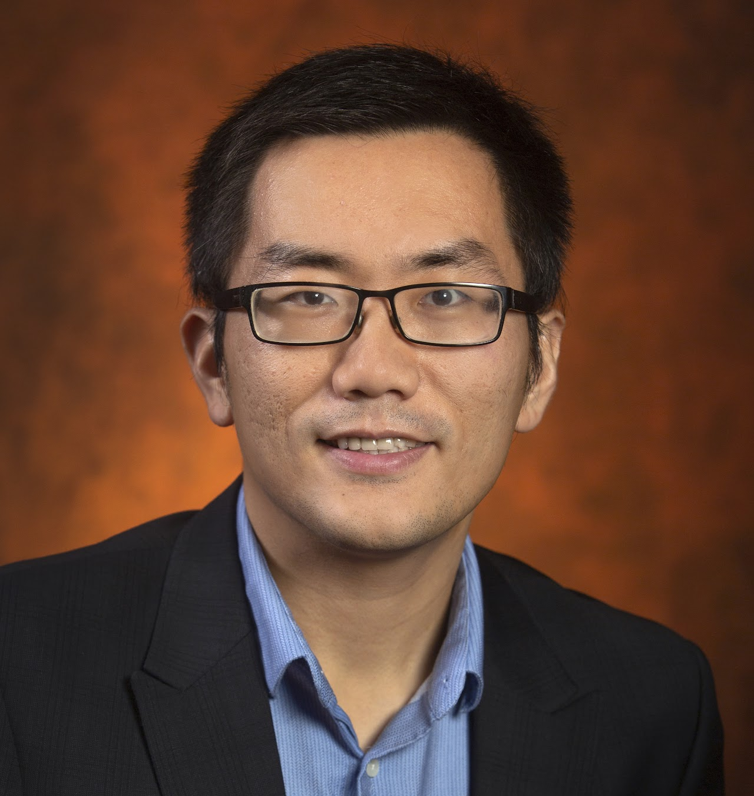
Health informatics and Aging
Artificial intelligence for Aging
Data mining and machine learning
Health data analytics
SHARE Program: Innovations in Translational Behavioral Science to Improve Self-management of HIV and Alcohol Reaching Emerging Adults (P01AA029547). PI: Sylvie Naar
Optimizing Alzheimer's Disease Clinical Trial Generalizability (R21AG061431-02S1, 2019-2022): PI: Zhe He
The Adherence Promotion with Person-centered Technology (APPT) Project: Promoting Adherence to Enhance the Early Detection and Treatment of Cognitive Decline (R01AG064529, 2019-2024): PI: Walter Boot
Systematic Analysis of Clinical Study Generalizability Assessment Methods with Informatics (R21AG061431, 2019-2022) PI: Zhe He
Zhe He
School of Information
zhe@fsu.edu
https://orcid.org/0000-0003-3608-0244
Health Data Analytics
Electronic Health Records
Machine Learning
Deep Learning
Natural Language Processing
Clinical data access
Natural language processing
Machine learning and deep learning
Grant writing
Connect to multidisciplinary researchers
Domain expertise
Grant writing

