Slide 1
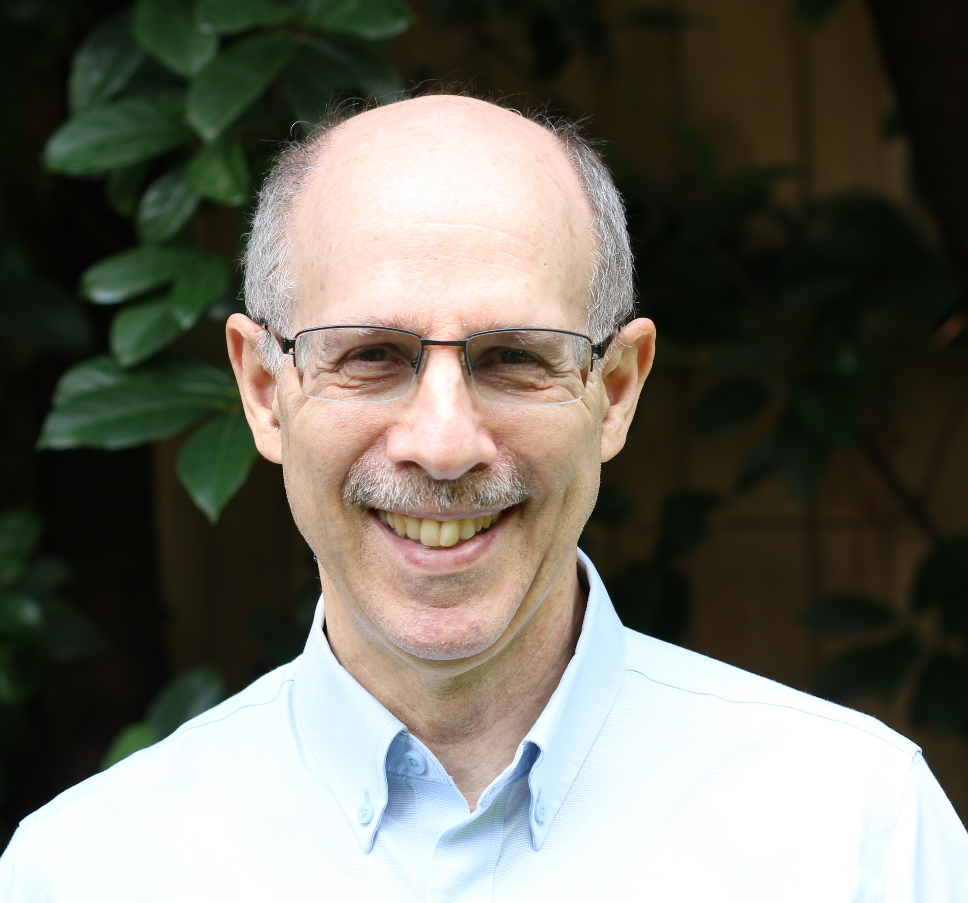
Finding ways to improve resilience in people as they age.
Predictive models for guiding technology interventions
Remote monitoring of health and well-being
Technology interventions for reducing social isolation and loneliness
APPT (Adherence Promotion with Person-centered Technology)
  Interdisciplinary NIA R01
ENHANCE (Enhancing Neurocognitive Health, Abilities, Networks, and Community Engagement)
  Interdisciplinary NIDILRR RERC
ASAP (Accessibility and Safety for the Aging Population)
  Interdisciplinary University Transportation Center
Institute for Successful Longevity team grant proposals
Neil Charness
Psychology/Institute for Successful Longevity
charness@psy.fsu.edu
http://orcid.org/0000-0002-1002-3439
Human factors methods
Cognitive aging intervention (RCT) studies
Age and technology use
Experimental methods for investigating expertise
Link you to researchers interested in aging and resilience
Link me to researchers interested in aging and resilience

