Slide 1
Affiliates Meeting
Friday, August 27th, 2021, Virtual Zoom Meeting, 11am-12pm

Slide 2
Bylaws Update
ISL needing feedback on the draft of the Bylaws we sent out with the copy of the agenda.
Thoughts or suggestions welcome! We hope to have the Bylaws finalized by the end of the year.

Slide 3
Thank You!
ISL would like to say thank you to those Affiliates members who have taken the time to show up to our virtual events, judging for judge roles when needed, & encouraging non-Affiliates members to show up at our events & volunteer.

Slide 4
Announcements/Awards/Promotions, etc.
Please continue to let ISL Staff know if you’ve received any awards or promotions or changes in tenure status so that we may properly announce it!

Slide 5
Congratulations to Sheila Salyer!
Please join us in congratulating Sheila Salyer as she celebrates 25 years as Director of TSC!
Congratulations, Sheila!

Slide 6
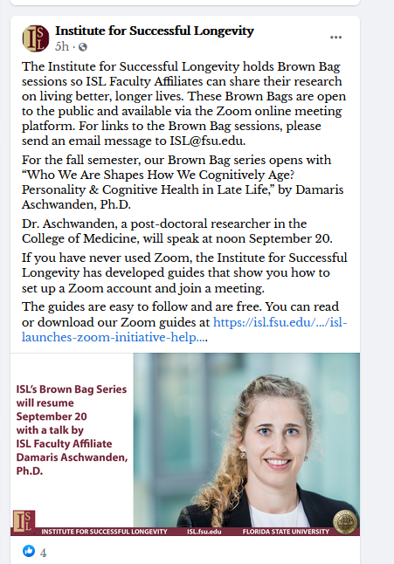
Examples of ISL’s media presence
ISL Blog, article by Dr. Charness: “An End to the Aging of the Population? What the New Numbers on Life Expectancy Could Mean?”
Link: https://isl.fsu.edu/article/end-aging-population-what-new-numbers-life-expectancy-could-mean
The controversy over Aduhelm – newest approved drug for Alzheimer’s disease — and why scientists are alarmed
Link: https://isl.fsu.edu/article/controversy-over-aduhelm-newest-approved-drug-alzheimers-disease-and-why-scientists-are
Examples of our Facebook Postings

Slide 7
Please welcome Norman B. Schmidt, Distinguished Research Professor as ISL’s newest Affiliate.
Please welcome Dr. Norman B (Brad) Schmidt as ISL’s newest Affiliate.
His research focuses on the nature, causes, treatment and prevention of anxiety and related psychopathology. He is interested in developing treatments for distress among individuals with Mild Cognitive Impairment and early Alzheimer’s disease as well as their caregivers.

Slide 8
ISL Faculty Affiliates Robert Hickner & Michael Ormsbee win $3 million NIH Grant
A multidisciplinary team of Florida State University researchers, led by two Faculty Affiliates of the Institute for Successful Longevity, has received a $3-million National Institutes of Health grant to examine how resistance training may help older women struggling with obesity to potentially prevent Type 2 diabetes. Professors of Nutrition and Integrative Physiology Robert Hickner and Michael Ormsbee, both ISL Faculty Affiliates, will co-lead the project, which also will include colleagues from the FSU College of Health and Human Sciences and the Pennington Biomedical Research Center in Louisiana as well as the University of Arkansas. The co-investigators at FSU are Claire Berryman, Ph.D., from Nutrition and Integrative Physiology and Thomas Ledermann, Ph.D., from Human Development and Family Science, in the College of Health and Human Sciences, and Michael Sweeney, M.D., from the Department of Clinical Sciences, in the College of Medicine. Read more: https://isl.fsu.edu/article/robert-hickner-michael-ormsbee-and-team-win-nih-grant-explore-resistance-training-and-type

Slide 9
Thank You for Turning In Updated FEAS for Annual Report!
ISL would like to thank our Affiliates for turning in the required information requested of the institute by the Provost Office on time. We hope that next year they will only require 1 years’ worth of information instead of 3 as it has taken the place of the seven-year evaluation.

Slide 10
Deadline for Call for Abstracts for Academic AFU Symposium Due by September 26th, 2021
Deadline to turn in your abstracts is September 26th.
The abstract word limit is 150-200 words and should be sent to Dr Cathy Fowley (cathy.fowley@dcu.ie ) and Dr Roger Baldwin (rbaldwin@msu.edu ) by September 26th, 2021.

Slide 11
ISL Survey Monkey Planning Grants Website Will be Up Later this Fall
ISL’s migrated Survey Monkey website from Fluid Review will be up at some point during the fall semester, date to be determined yet, and we will send out an announcement with more details to come.
Potential planning group sessions held via Zoom or Teams to discuss grant interest/projects?

Slide 12
Participant Registry
ISL has received increased requests for how to use our participant registry for researchers.
Link to access database is:
https://apps.psy.fsu.edu/isl/signin/admin.php
ISL offers a set of FAQ documents for how to login and access the database as well as troubleshooting basic problems.
Please email Callie at cperson@fsu.edu if you have any questions or concerns or if you would like access to these documents.

Slide 13
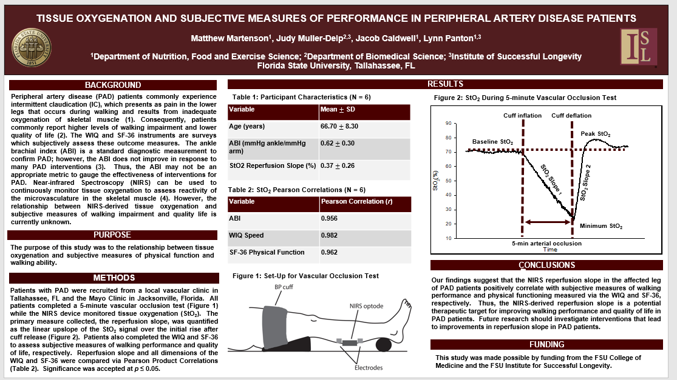
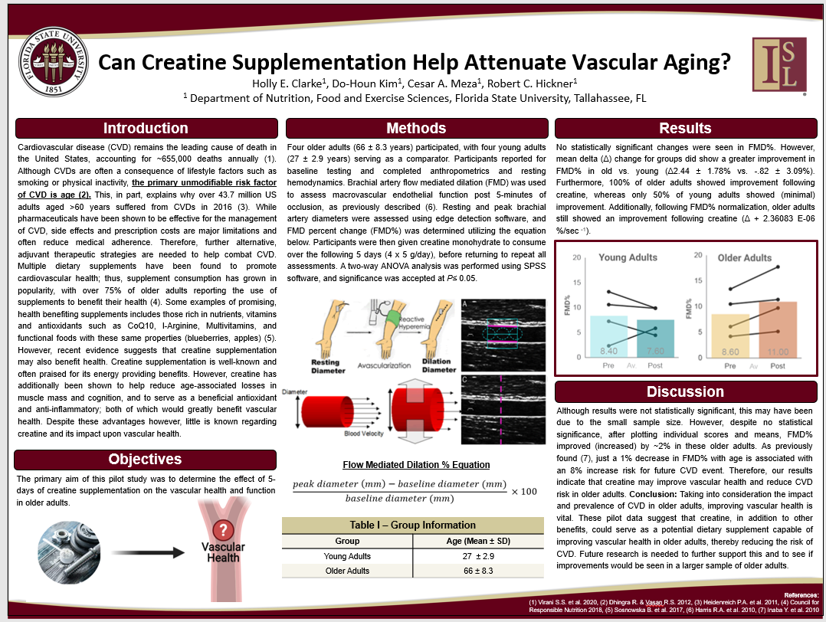
2021 Student Poster Day Winners
Hoping to host another Student Poster Day Event.
Virtual? In-Person?
Feedback welcome!

Slide 14
2022 ISL Spring Brown Bag Speakers & Spring Lecture Series Speaker-Need Volunteers!
ISL searching for spring speakers for our Brown Bag series. Need volunteers and/or suggestions of names of people interested in presenting for the Institute!
We are also searching for our Spring Lecture Series speaker, so if you know of any good candidates who would be interested in presenting with a topic that pertains to the institute’s mission, please let us know!

Slide 15
ISL potentially sponsoring speaker Jessica Kelley with the Claude Pepper Center
She will be presenting virtually September 30th at 2:00pm.
Title of her presentation to be determined.

Slide 16
Conference for 2 NSF RCNs April 14-16, 2022
The Conference will include presentations surrounding two NSF SCC-RCNs
One Bridge at a Time: Bridging the Digital Divide for the Well- Being of Aging Populations through Smart and Connected Communities
CoPe RCN: Resilient Rural Infrastructure
Transportation Day is a component.
College of Engineering, with Eren Ozguven & John Sobanjo heading the projects as team leads.
Planning committees having now hosted 3 Zoom sessions. Next Zoom session scheduled for Wed September 1st at 1:00 pm, also via Zoom.
Dates of event- April 14th-16th of 2022. Looking at hosting it at Turnbull Center.

Slide 17
Opening of Memory Care Units at Westminster Oaks
Dr. Charness recently met with a committee (Pat Hogan, Everett Yarborough) from Westminster Oaks to plan an event in October, which would be a week-long one to kick off the opening of Memory Care units at the Oaks.

Slide 18
ISL Helping Arrange University-Community Presentations
ISL helping to arrange for university-community presentations. Helped provide Mike Rashotte with a speaker for their lecture series. Dr. Brad Schmidt will be the speaker at the Forum presenting on October 5th, presenting on Anxiety in the COVID Era.

Slide 19
AFU-UMass-FSU Project Update
ISL received back the Age Friendly University Survey Results from UMass about how overall age-friendly FSU’s campus is.
The overall score was 65%.

Slide 20
ISL Brown Bags, Titles TBD
Damaris Aschwanden, Monday, September 20th, 12-1pm, PDB Room A211
Dr. Aaron Wilber, Monday October 4th, 12-1pm, PDB Room A204
Dr. Amy Ai, Monday, December 6th, 12-1pm, PDB Room A211
*Thoughts on having our Brown Bags as fully virtual vs. hybrid to address COVID concerns?

Slide 21
GSA Conference Room in Phoenix, AZ booked
Dr. Charness was able to reserve a room for the Age Director’s Meeting in Phoenix, AZ, booked for Friday November 12th from 3:00-4:15 pm Arizona time.

Slide 22
Dr. Charness Collaborating with Patricia Heyn at University of Colorado Anschutz Medical Campus on a potential R13 grant application sponsored by GSA.
Dr. Charness met with Dr. Heyn on a potential R13 grant app. Sponsored by GSA to discuss options.

Slide 23
Dr. Charness Schedule of Events
Presented at the U Michigan Human Factors short course (Aging & Inclusive Design) July 31
Birmingham NEXT lecture June 17
CHP Savvy Seniors June 18
Dr. Charness talking in the Milton S. Carothers Luncheon Series at Strozier Library scheduled for October 18.
Create Workshop, Bordeaux, France (September 23-24.)

Slide 24
Questions/Feedback?
Suggestions/Input are welcome!

