Slide 1
Affiliates Meeting
Wednesday, March 10th, 2021, Virtual Zoom Meeting, 1pm-2pm

Slide 2
Grants Update
ISL still sending out Funding Opportunity Announcement (FOA) Notices
Current FOA Opportunities:
Sandell Grant program, to do research in retirement & disability for junior & non-tenured scholars, courtesy of David Lipten.
A Dissertation Fellowship (also from David Lipten) from CRR re retirement & disability.
NIDILRR grant on Reducing Social Isolation and Loneliness for People with Disabilities, courtesy of Wally Boot

Slide 3
Thank You!
ISL would like to say thank you to those Affiliates members who have taken the time to show up to our virtual events, judging for judge roles when needed, & encouraging non-Affiliates to show up at our events & volunteer.

Slide 4
Announcements/Awards/Promotions, etc.
Please continue to let ISL Staff know if you’ve received any awards or promotions or changes in tenure status so that we may properly announce it!

Slide 5
ISL Faculty Affiliate Walter Boot in the Washington Post
Walter Boot, Ph.D., of the Department of Psychology and a Faculty Affiliate of the Institute for Successful Longevity, is quoted by the Washington Post in this article about “What really works to help an aging brain.”
https://www.washingtonpost.com/health/help-for-aging-brains/2021/03/05/717ab738-79d6-11eb-85cd-9b7fa90c8873_story.html

Slide 6
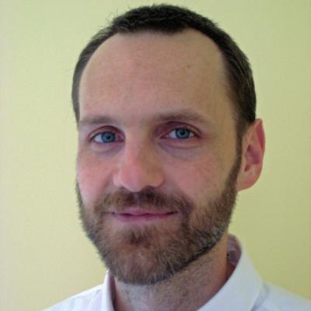
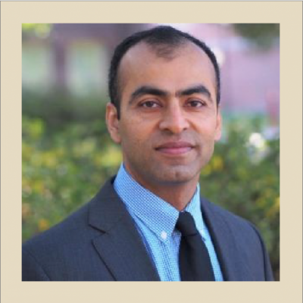
Please Welcome our new Affiliates Members!
Please welcome Dr. Michael Duncan! He is an Associate Professor in the Department of Urban and Regional Planning in the College of Social Sciences & Public Policy. He received his Ph.D. from the University of California, Berkeley. His research and teaching focus on sustainable transportation planning that mitigates environmental impacts and improves social equity. This includes research that focuses on providing better transportation options for older adults.
Please welcome Dr. Ravinder Nagpal! He is Assistant Professor of Nutrition, Food & Exercise Sciences in the College of Human Sciences. He received his Ph.D. in Food & Dairy Microbiology from National Dairy Research Institute in Haryana, India. He undertook postdoctoral trainings in gut microbiology from Juntendo School of Medicine in Tokyo and Wake Forest School of Medicine in Winston-Salem, N.C. His research spans around understanding the host-associated microbiome and the dynamics of diet-gut-brain interface at the extremes of aging and in aging-associated metabolic and cognitive health.

Slide 7
ISL Survey Monkey/Planning Grants Website Update
ISL’s Survey Monkey Website Now Open for Applications.
Deadline to Apply is March 23, 2021
Award Notification: May 1st, 2021
Award Period: May 14-May 15th, 2021
Please note that when submitting suggested reviewers for your proposal, Reviewers must be internal with Florida State University and must not present any conflict of interest for the application and scoring process.
Please note that Fluid Review will be deactivated per an announcement from FSU ITS as of March 30th, 2021, so please use the new Survey Monkey website link below to submit your applications.
Link to apply: https://isl-fsu-sm.smapply.us/
If you need assistance with the application process and how to navigate the website, please email Callie Kindelsperger at cperson.fsu.edu

Slide 8
2021 Student Poster Day Event via Zoom
ISL recently hosted our 2021 Student Poster Day on Friday, March 5th, from 2-3:30pm, via Zoom. 6 students presented.
1. Holly Clarke, PhD student in NFES under Dr. Robert Hickner, Title of Presentation: “Can Creatine Supplements Help Attenuate Vascular Aging?”
2. Christopher Schattinger, PhD student under Dr. Lynn Panton. Title of presentation: Assessment Of Muscle Mass in Transcatheter Aortic Valve Replacement Patients Over ~6 Months Post-procedure
3. Matthew “Jake” Martenson, PhD student under Dr. Lynn Panton. Title of presentation: Tissue Oxygenation, Ankle-brachial Index, and Subjective Measures of Performance in Peripheral Artery Disease Patients.
4. Ashley Archer, master’s student under Dr. Elizabeth Madden-Title of presentation-“The Effect of Cognitive-Linguistic Load on Gait Performance in Persons with Aphasia.”
5. Mahyar Ghorbanzadeh, student under Eren Erman Ozguven. Title of presentation: Spatiotemporal Analysis of Highway Traffic Patterns in Hurricane Evacuation: A Case Study of Hurricane Irma in Florida.
6. Michael Prevratil, student until Neil Charness, Title of presentation: The AUGMENT Project: Predicting Wayfinding Difficulty Within a Community Sample of Older Adults.”

Slide 9
2021 Student Poster Day Winners
Ashley Archer (School of Communications Science & Disorders)-1st prize.
Holly Clarke (College of Human Sciences)-2nd prize.
Matthew Martenson (Department of Nutrition, Food, & Exercise Science) – 3rd prize.
Congratulations to our winners and a huge thank you again to all who participated in the event, and who came out to support the students!
A huge thank you to Dr. Charness, Dr. Edmonds, and Dr. Judy Delp for serving as the judges for our poster event, and to all the students who volunteered and shared their posters/research with the Institute!

Slide 10
IPE Journal Club Dates for 2021
May 10th, 12-1pm, EST, Zoom
August 9th, 12-1pm, EST
November 8th, 12-1pm EST

Slide 11
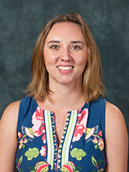
2021 Esther & Del Grosser Scholarship
Please congratulate this year’s winner Melissa Meynadasy, Psychology Department, for the Esther & Del Grosser Scholarship!
Her advisor is Natalie Sachs-Ericsson, Psychology

Slide 12
ISL Brown Bags
Upcoming ISL Brown Bags
Lauchlin Waldoch, March 15th, 12-1pm, EST, Zoom, “Essential Incapacity Planning: Powers of Attorney, Health Care Directives & Trusts.”

Slide 13
2021 ISL Spring Speaker, Bo Xie
Dr. Bo Xie will be presenting on Aging in the Digital Era on Thursday, May 13th at 4 p.m. EDT.
We hope to host the Zoom session as a webinar that we can register up to 100 attendees for, to be circulated a week before the event. Stay turned for more updates!

Slide 14
2021 Annual GSA Updates
Age Director’s Interest Meeting via Zoom was on Thursday, Feb. 25th from 2-3pm, EST.
Had upwards of 27 attendees and discussed a wide variety of topics, including planning a memorial remembrance service for Kathy Hyer, what people are doing related to AFU Initiative, COVID Topic & Vaccinations, vaccinating older people of color, and more.

Slide 15
Next JAB Meeting
Next Joint Advisory Board meeting scheduled for Thursday, May 4th, 3-4pm, EDT via Zoom.
This Photo by Unknown Author is licensed under CC BY-SA

Slide 16
AFU-UMass-FSU Project Update
Data collection completed in full and sent off to UMass. We hope that the university will make good of the FSU data that we have collected for them.

Slide 17
Director Presentations
Dr. Charness recently presented a keynote presentation at virtual conference entitled "Technologies for Active and Independent Living in Old Age", to be online on February 10-11, 2021, in the framework of long-term (eng)aging! project. Czech Republic.
March 25: Keynote address in William F. Forbes Lecture Series, University of Waterloo, Canada.
CREATE workshop in Bordeaux, France, Fall 2021.

Slide 18
Questions/Feedback?
Suggestions/Input are welcome!

