Slide 1
Affiliates Meeting
Wednesday, January 20th, 2021, Virtual Zoom Meeting, 2pm-3pm

Slide 2
Grants Update
ISL still sending out Funding Opportunity Announcement (FOA) Notices
Current FOA Opportunities:
Sandell Grant program, to do research in retirement & disability for junior & non-tenured scholars, courtesy of David Lipten.
A Dissertation Fellowship (also from David Lipten) from CRR re retirement & disability.

Slide 3
Announcements/Awards/Promotions, etc.
Please continue to let ISL Staff know if you’ve received any awards or promotions or changes in tenure status so that we may properly announce it!

Slide 4
Dr. Rebok & Dr. Panton’s Presentations Now on ISL Website
In case you were unable to attend both virtual Zoom sessions, the recorded sessions are now available on our ISL Website listed under ‘News.’

Slide 5
ISL Fluid Review/Planning Grants Website Update
ISL’s Fluid Review Website Now Open for Applications.
Deadline to Apply is March 23, 2021
Award Notification: May 1st, 2021
Award Period: May 14-May 15th, 2021
Please note that when submitting suggested reviewers for your proposal, Reviewers must be internal with Florida State University and must not present any conflict of interest for the application and scoring process.
Link to apply: https://isl-fsu.us.fluidreview.com/
If you need assistance with the application process and how to navigate the website, please email Callie Kindelsperger at cperson.fsu.edu
Important Note: FluidReview is migrating Over to new site called SurveyMonkey, date of migration TBD. Please DO NOT submit anything until the migration is complete. Once it is, Callie will send out an email announcing the change with updated links.

Slide 6
2021 Student Poster Day Event via Zoom
Date of event is Friday, March 5th, from 2-5pm, via Zoom.
So far, have upwards of 7 students signed up to present at event.
The Deadline for your students to apply for the Esther & Del Grosser Scholarship is Feb. 15th, 2021. Award amount is $750. They do not have to present at Student Poster Event in order to be eligible to apply for the scholarship, they are treated as two separate events, however, we would like to award the winner during the event.
Callie will send out the application instructions for your students in an email as a reminder. Will continue to send out until few days prior to the deadline.

Slide 7
IPE Journal Club Dates for 2021
Feb. 15th, 12-1pm, EST, Zoom
May 10th, 12-1pm, EST, Zoom
August 9th, 12-1pm, EST
November 8th, 12-1pm EST

Slide 8
ISL Brown Bags
Upcoming ISL Brown Bags
Maxim Dulebenets, Jan 25th, 12-1pm, EST, Zoom, “Safety of Vulnerable Drivers at Highway-Railroad Intersections in Florida".
Judy Delp, Feb. 22nd, 12-1pm, EST, Zoom, “Muscle Stretch Training Improve Mobility in Older Adults.”
Lauchlin Waldoch, March 15th, 12-1pm, EST, Zoom, “Essential Incapacity Planning: Powers of Attorney, Health Care Directives & Trusts.”

Slide 9
2021 ISL Spring Speaker, Bo Xie
Dr. Bo Xie has graciously agreed to be our virtual spring speaker.
Dates for her virtual Zoom lecture and faculty Zoom meetings/grad student luncheon on Thurs. May 13th, 2021.

Slide 10
2021 Annual GSA Updates
ISL has taken initiative to set up a meeting in February for the Age Directors to meet prior to next year’s GSA event to discuss agenda topics.
Age Director’s Interest Meeting via Zoom to be held on Thursday, Feb. 25th from 2-3pm, EST.

Slide 11
Next JAB Meeting
Next Joint Advisory Board meeting scheduled for Monday, February 8th, 3-4pm, EST via Zoom.
This Photo by Unknown Author is licensed under CC BY-SA

Slide 12
AFU-UMass-FSU Project Update
Data collection continues to go well. Callie continuing to get responses from different departments within FSU.
Data collection due in full by March 1st.

Slide 13
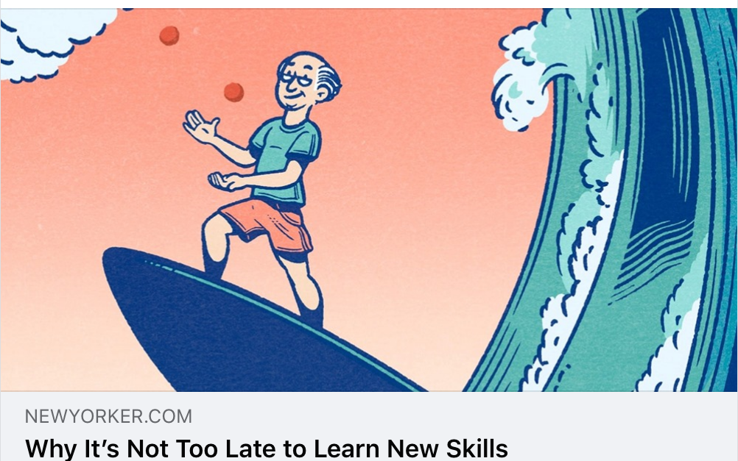
ISL cited in The New Yorker article on COVID-19
Dr. Charness is cited in The New Yorker in a review of “Beginners: The Joy and Transformative Power of Lifelong Learning,” by journalist and author Tom Vanderbilt.
https://www.newyorker.com/magazine/2021/01/18/is-it-really-too-late-to-learn-new-skills

Slide 14
ISL Featured in FSU News surrounding COVID-19
In the Tallahassee Democrat as well:
https://www.tallahassee.com/story/news/2021/01/13/covid-vaccine-shots-begin-those-65-and-older-fsu/6650832002/
In WTXL, Tallahassee’s ABC stations, Bill Edmonds featured in video (not quoted): https://www.wtxl.com/news/coronavirus/florida-state-university-begins-administering-covid-19-vaccine
https://news.fsu.edu/news/university-news/2021/01/13/fsu-administers-first-round-of-vaccines-to-65-plus-population/?utm_source=newsletter&utm_medium=email&utm_campaign=the_big_story_january_19_2021&utm_term=2021-01-19

Slide 15
Director Presentations
Feb. 10/11: Keynote in virtual conference entitled "Technologies for Active and Independent Living in Old Age", to be online on February 10-11, 2021, in the framework of long-term (eng)aging! project. Czech Republic.
March 25: Keynote address in William F. Forbes Lecture Series, University of Waterloo, Canada.
CREATE workshop in Bordeaux, France, Fall 2021.

Slide 16
Questions/Feedback?
Suggestions/Input are welcome!

