Slide 1
Affiliates Meeting
Wednesday, September 30th, 2020, Virtual Zoom Meeting, 12pm-1pm

Slide 2
Grants Update
ISL still sending out Funding Opportunity Announcement (FOA) Notices

Slide 3
Announcements/Awards/Promotions, etc.
Please congratulate Dr. Zhe He on the birth of his son Vincent Haoran He!

Slide 4
Friendly Reminder
Just a friendly reminder when you give press/media interviews of any kind that deal with aging or AFU, to please mention your affiliation with the Institute for Successful Longevity, and for online Zoom interviews where appropriate, please use the ISL-FSU background that Bill Edmonds has graciously provided.
If you need the backdrop, please email Callie Kindelsperger @cperson.fsu.edu to request the image.

Slide 5
ISL Fluid Review/Planning Grants Website Update
ISL is working diligently to ensure that the Fluid Review/Planning Grants website will be open soon and accepting applications for the 2021-2022 year. Will be sending out emails shortly with updates.

Slide 6
2020 ISL Fall Speaker, George Rebok
Dr. George Rebok will be presenting virtually at 3:30 pm on Thursday, December 3.
Topic: Preventing Cognitive Decline and Alzheimer's Disease Dementia: The Evidence for Cognitive Training – George W. Rebok, PhD, MA
Will be sending around email invitations shortly for faculty members who want to meet with Dr. Rebok via Zoom, as well as hosting a 1-hour virtual ‘grad student luncheon.’

Slide 7
2020 Annual GSA Meeting Now Virtual
This year’s 2020 GSA meeting has been moved to Zoom, hosted November 4-8th.
There will be a Directors of Aging Centers Interest Group meeting on Monday, Oct. 19th via Zoom at 4pm to discuss agenda items.

Slide 8
City Wellness and Retirement Conference Update
ISL partnered with the City of Tallahassee to host a virtual Wellness and Retirement conference on Tuesday, Sept. 22nd.
Dr. Dawn Carr gave the keynote and hosted 2 breakout sessions.
Dr. Charness also hosted two breakout sessions.

Slide 9
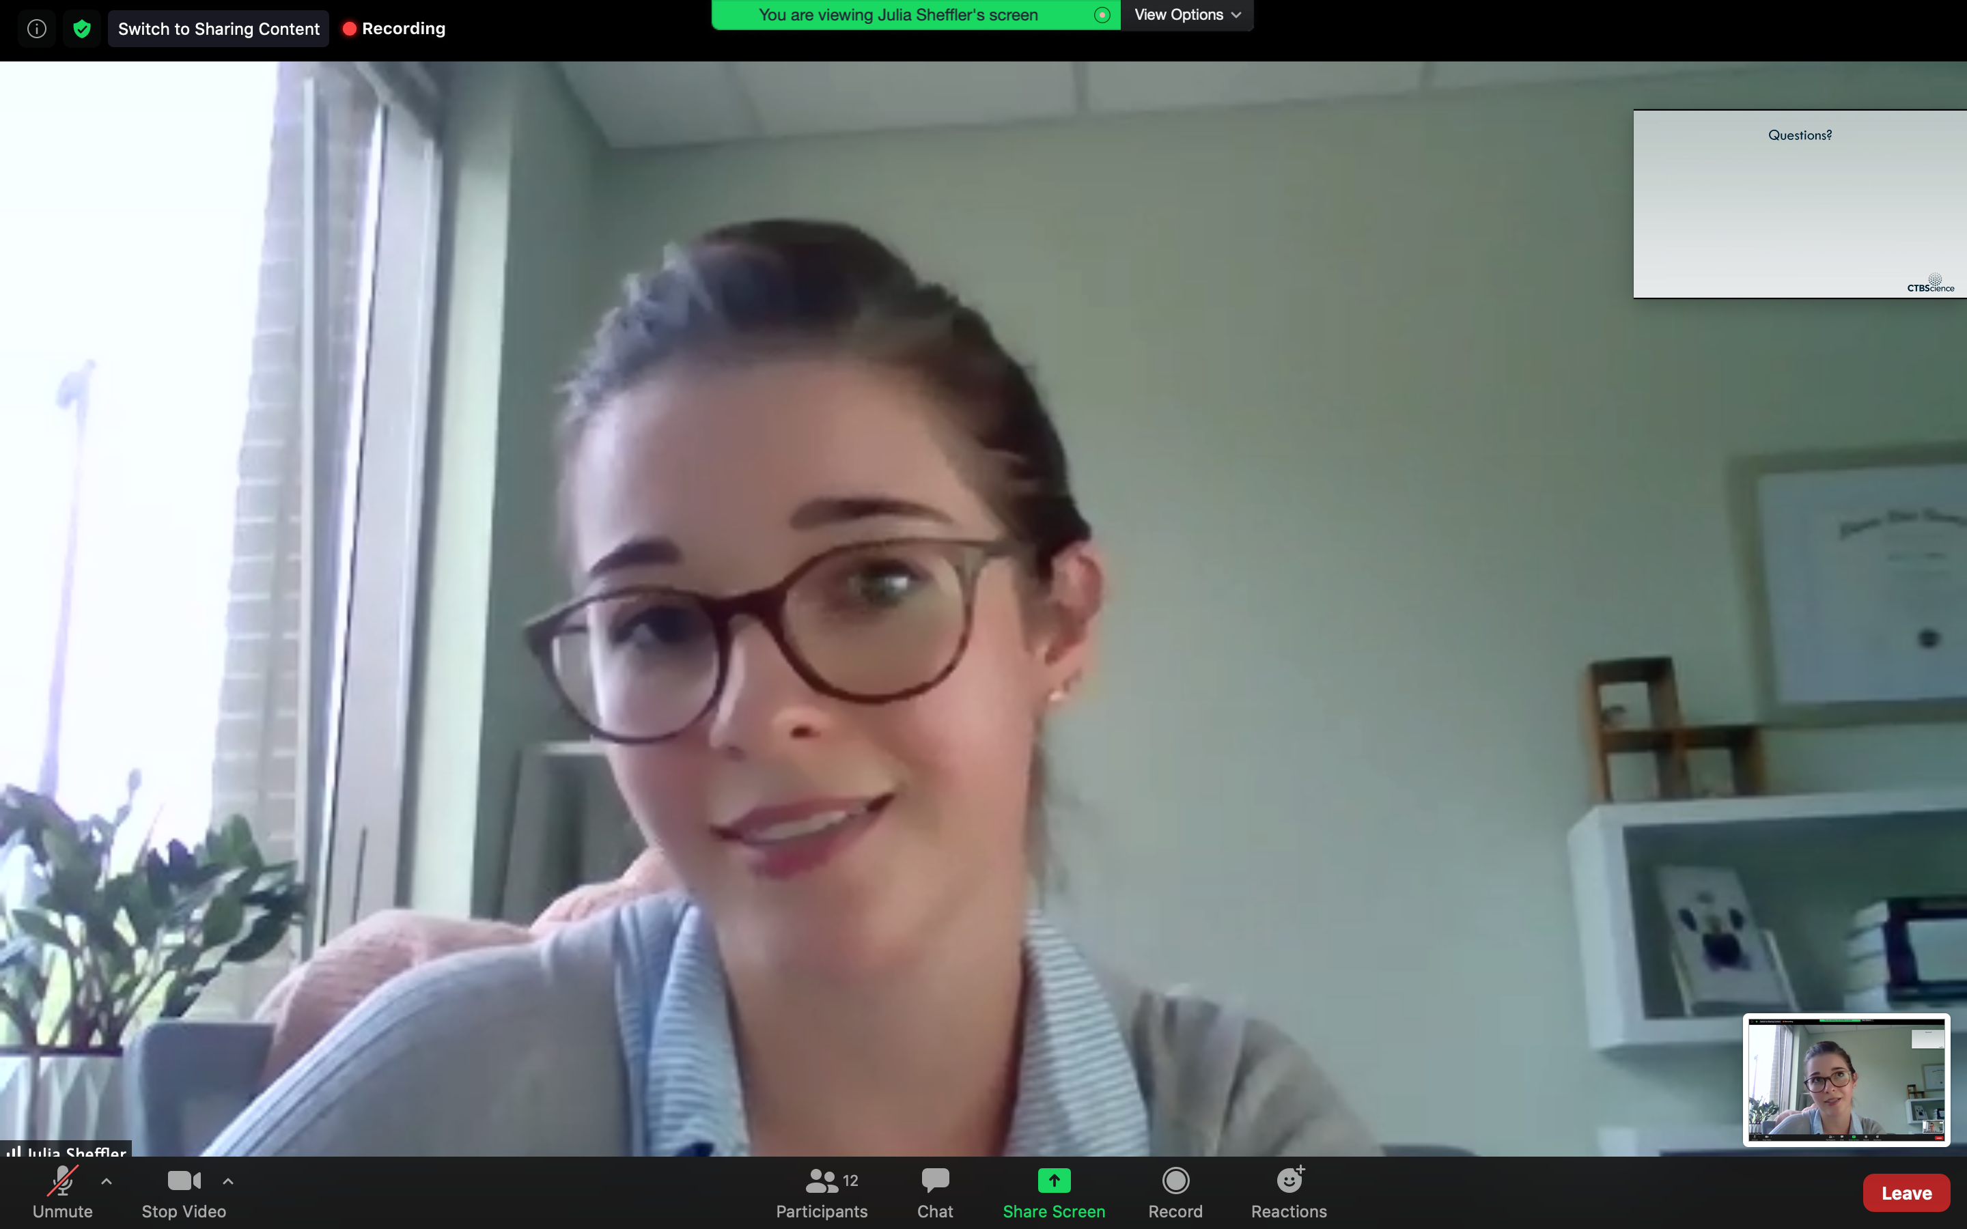
ISL Brown Bags
We would like to thank Julia Sheffler for presenting on Mon, Sept. 21st.

Slide 10
ISL Brown Bags, cont.
Upcoming Brown Bags
Yanshuo Sun, Monday, October 5th, 12-1pm Zoom
IPE Journal Club, Zoom, Monday November 9th, 12-1pm
December- Lynn Panton, Monday, December 7th, 2-3pm

Slide 11
Next JAB Meeting
Next Joint Advisory Board meeting scheduled for Monday, November 30th, 12-1pm via Zoom.
This Photo by Unknown Author is licensed under CC BY-SA

Slide 12
2020 Transportation Day Update
This year’s Transportation Day has been moved to an entirely online event, to take place on Zoom October 16^{th.} More details to come. Mark your calendars! We will circulate links soon!

Slide 13
Using Technology to Promote Health and Social Connectivity in the Age of COVID-19
Dr. Charness was invited to be on a virtual panel discussion Oct. 27 sponsored by University of Maine: Using Technology to Promote Health and Social Connectivity in the Age of COVID-19.
Also invited to give (virtually) the William F. Forbes Lecture in November, in the University of Waterloo Network for Aging and Technology Conference: Aging and Technology in the Time of COVID-19 and Beyond.

Slide 14
ISL’s Zoom Initiative Project receiving positive feedback
ISL’s How-To Zoom guides featured on our website continues to receive positive feedback and make an impact in the community’s lives, with an example featured below.

Slide 15
New Business Updates
Student Poster Day-looking to host a potentially virtual Student Poster Day in Spring.
Suggestions/Feedback are welcome!
This Photo by Unknown Author is licensed under CC BY-SA

Slide 16
International Day of Older Persons October 1

