Slide 1
Affiliates Meeting
Monday, March 30th, Virtual Zoom Meeting, 11am-12pm

Slide 2
Grants Update
ISL still sending out FOA Notices
Please coordinate with us and Evangeline Ciupek eciupek@fsu.edu if you are planning a Retirement Research Foundation proposal

Slide 3
ISL Fluid Review Grant Website
ISL’s Planning Grant website now closed for applications
In the process of reviewing documentation and assigning reviewers.
Award Notification: May 1st, 2020
Award Period: May 14th-May 15th

Slide 4
Awards, Honors/Promotions
Let us know if you’ve received any changes in tenure status, promotions, or received any awards!

Slide 5
Upcoming ISL Brown Bags
April 21st, Jingjiao Guan, PBD A402B, 12pm-1pm, “Development of Microdevices for Enhancing Cell Therapies.”
This will be scheduled as a Zoom session.

Slide 6
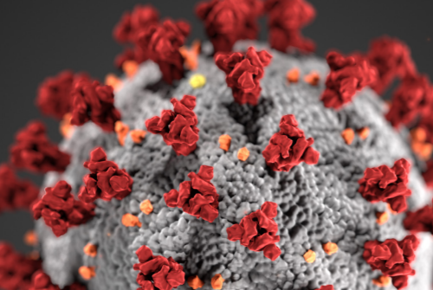
2020 City Wellness Conference Update
City Wellness & Retirement Conference has been moved to Tuesday, September 22nd due to Corona Virus precautions.
Notes:
Image from https://www.cdc.gov/coronavirus/2019-ncov/downloads/fs-CERC-Infectious-Disease.pdf

Slide 7
2020 Student Poster Research Day
Has been rescheduled to a later date in the fall due to Corona Virus precautions. Date TBD.
This Photo by Unknown Author is licensed under CC BY-SA-NC
Notes:
Corona Virus Image from https://www.cdc.gov/coronavirus/2019-ncov/downloads/fs-CERC-Infectious-Disease.pdf

Slide 8
Transportation Day 2020
Transportation Day also moved to sometime in the fall. Date has yet to be determined.
Notes:
Corona Virus Image from https://www.cdc.gov/coronavirus/2019-ncov/downloads/fs-CERC-Infectious-Disease.pdf

Slide 9
ISL 2020 Spring Speaker
Karen Fingerman’s visit to the Claude Pepper Center has been postponed. Will most likely try to reschedule for later in the fall semester.

Slide 10
Next Joint Advisory Board Meeting
JAB meeting scheduled for May 6th, Room A211. This will likely be rescheduled as a Zoom meeting.
This Photo by Unknown Author is licensed under CC BY-SA-NC
This Photo by Unknown Author is licensed under CC BY-NC-ND

Slide 11
Director’s Travel Schedule
Postponed until further notice and/or all meetings have switched to virtual unless otherwise announced. All FSU travel was suspended when the Corona Virus outbreak was announced.

