Slide 1
Affiliates Meeting
Monday, Jan 27th, 1pm-2pm, PDB A211

Slide 2
Grants Update
ISL still sending out FOA Notices
NIDILRR ENHANCE grant has been funded. $4.6 million grant awarded to establish a new RERC Center, with focus on developing technologies to improve lives of older adults with cognitive impairment.

Slide 3
NIDILRR RERC

Slide 4
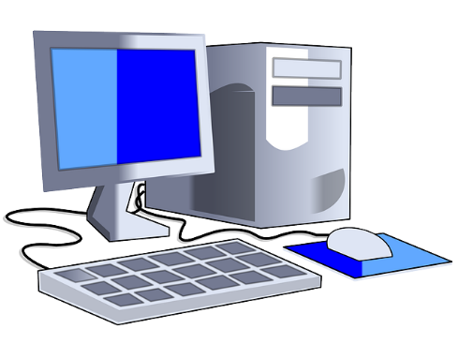
ISL Fluid Review Grant Website
ISL’s Planning Grant website now up and running!
Application Deadline: March 23rd
Award Notification: May 1st
Award Period May 14-15, 2020
Link to apply: https://isl-fsu.us.fluidreview.com/

Slide 5
Judy Delp Talk on Newcomer’s Club
Judy Delp recently gave a presentation on successful longevity at the Tallahassee Women’s Newcomer’s Luncheon on January 8th.

Slide 6
Friendly Reminder: Still Need Student Publications/Guides/Chapters for ISL Annual Report
Friendly reminder: if you have not already done so, we are still in need of your work involving your students: guides, publications, chapters, etc. Please email if applicable to Callie at cperson@fsu.edu
Thank you!

Slide 7
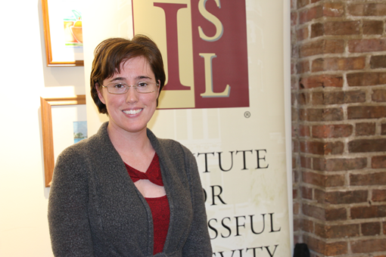
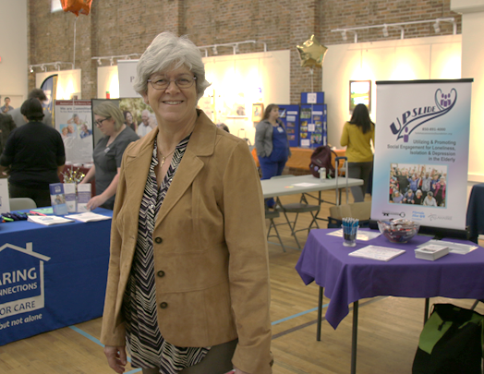
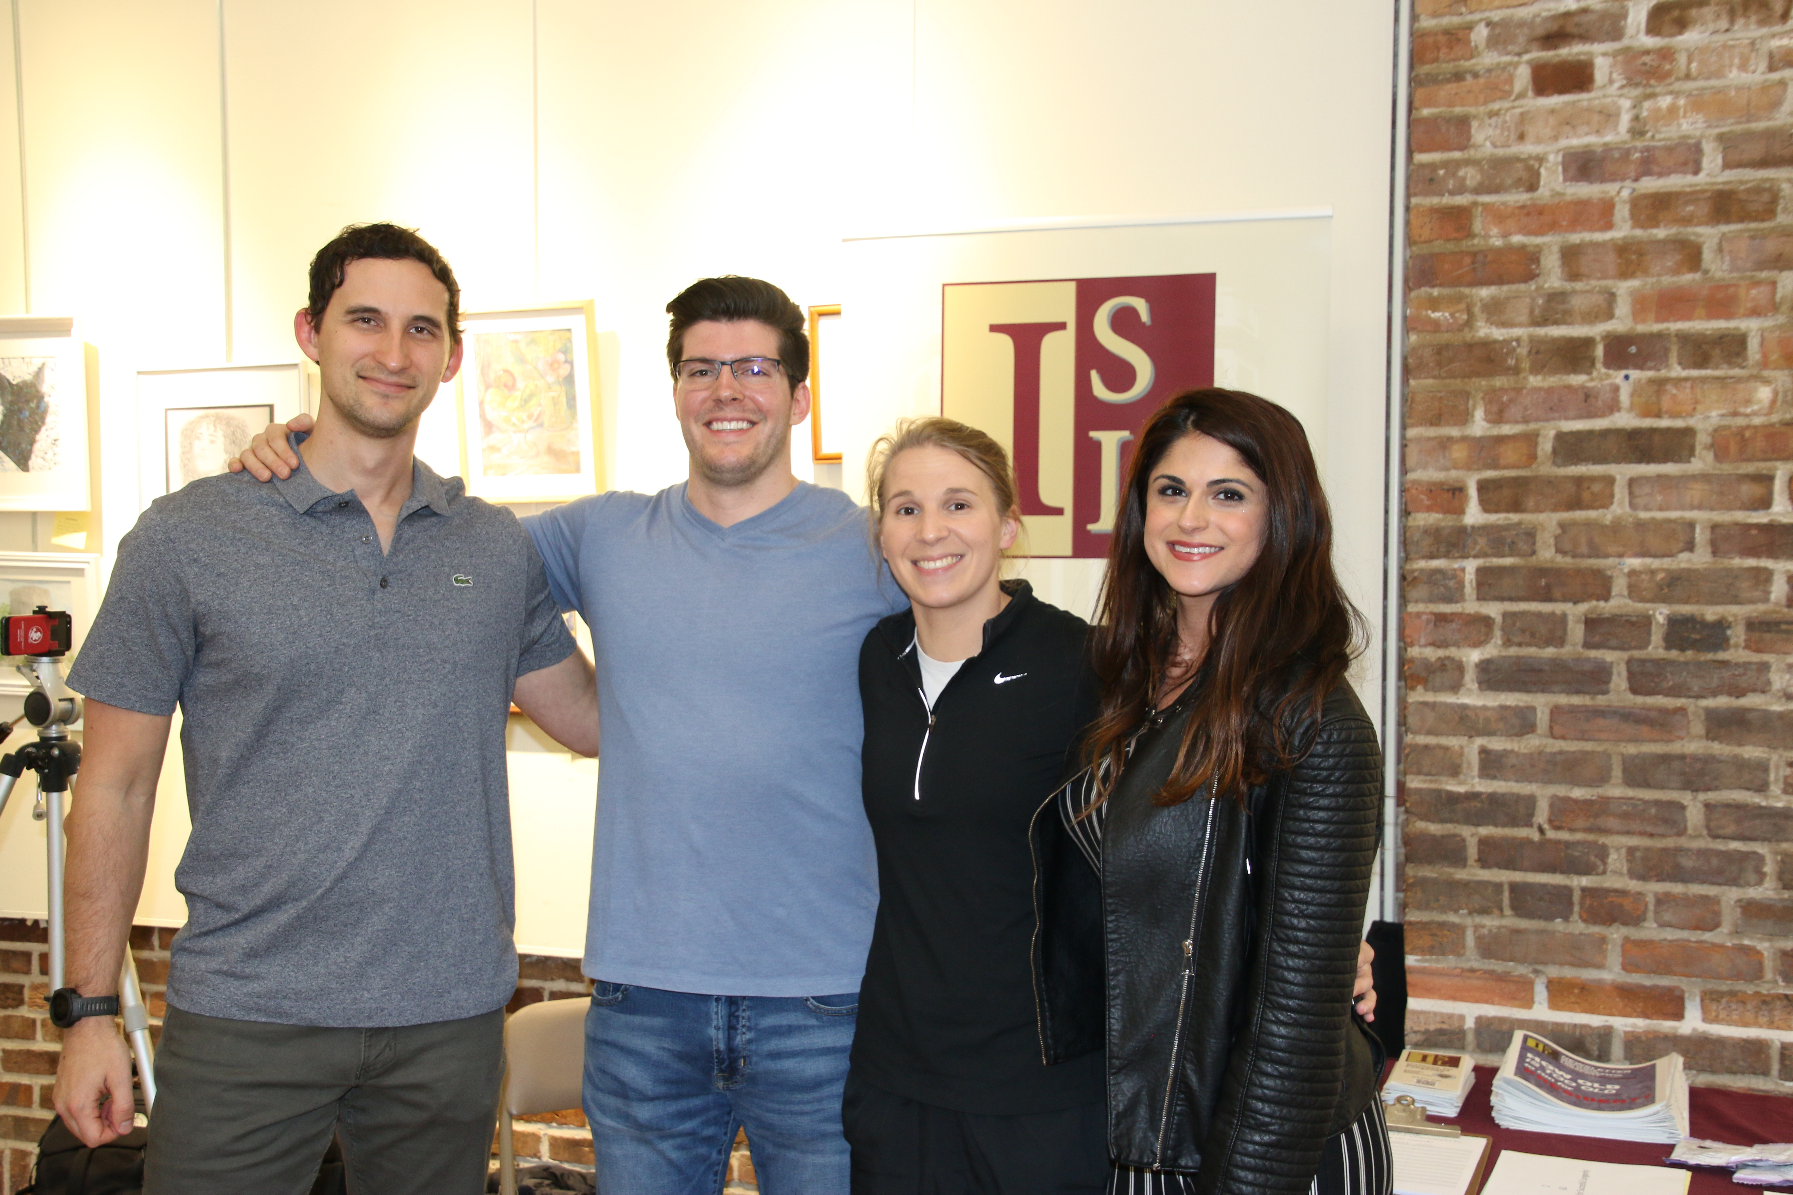
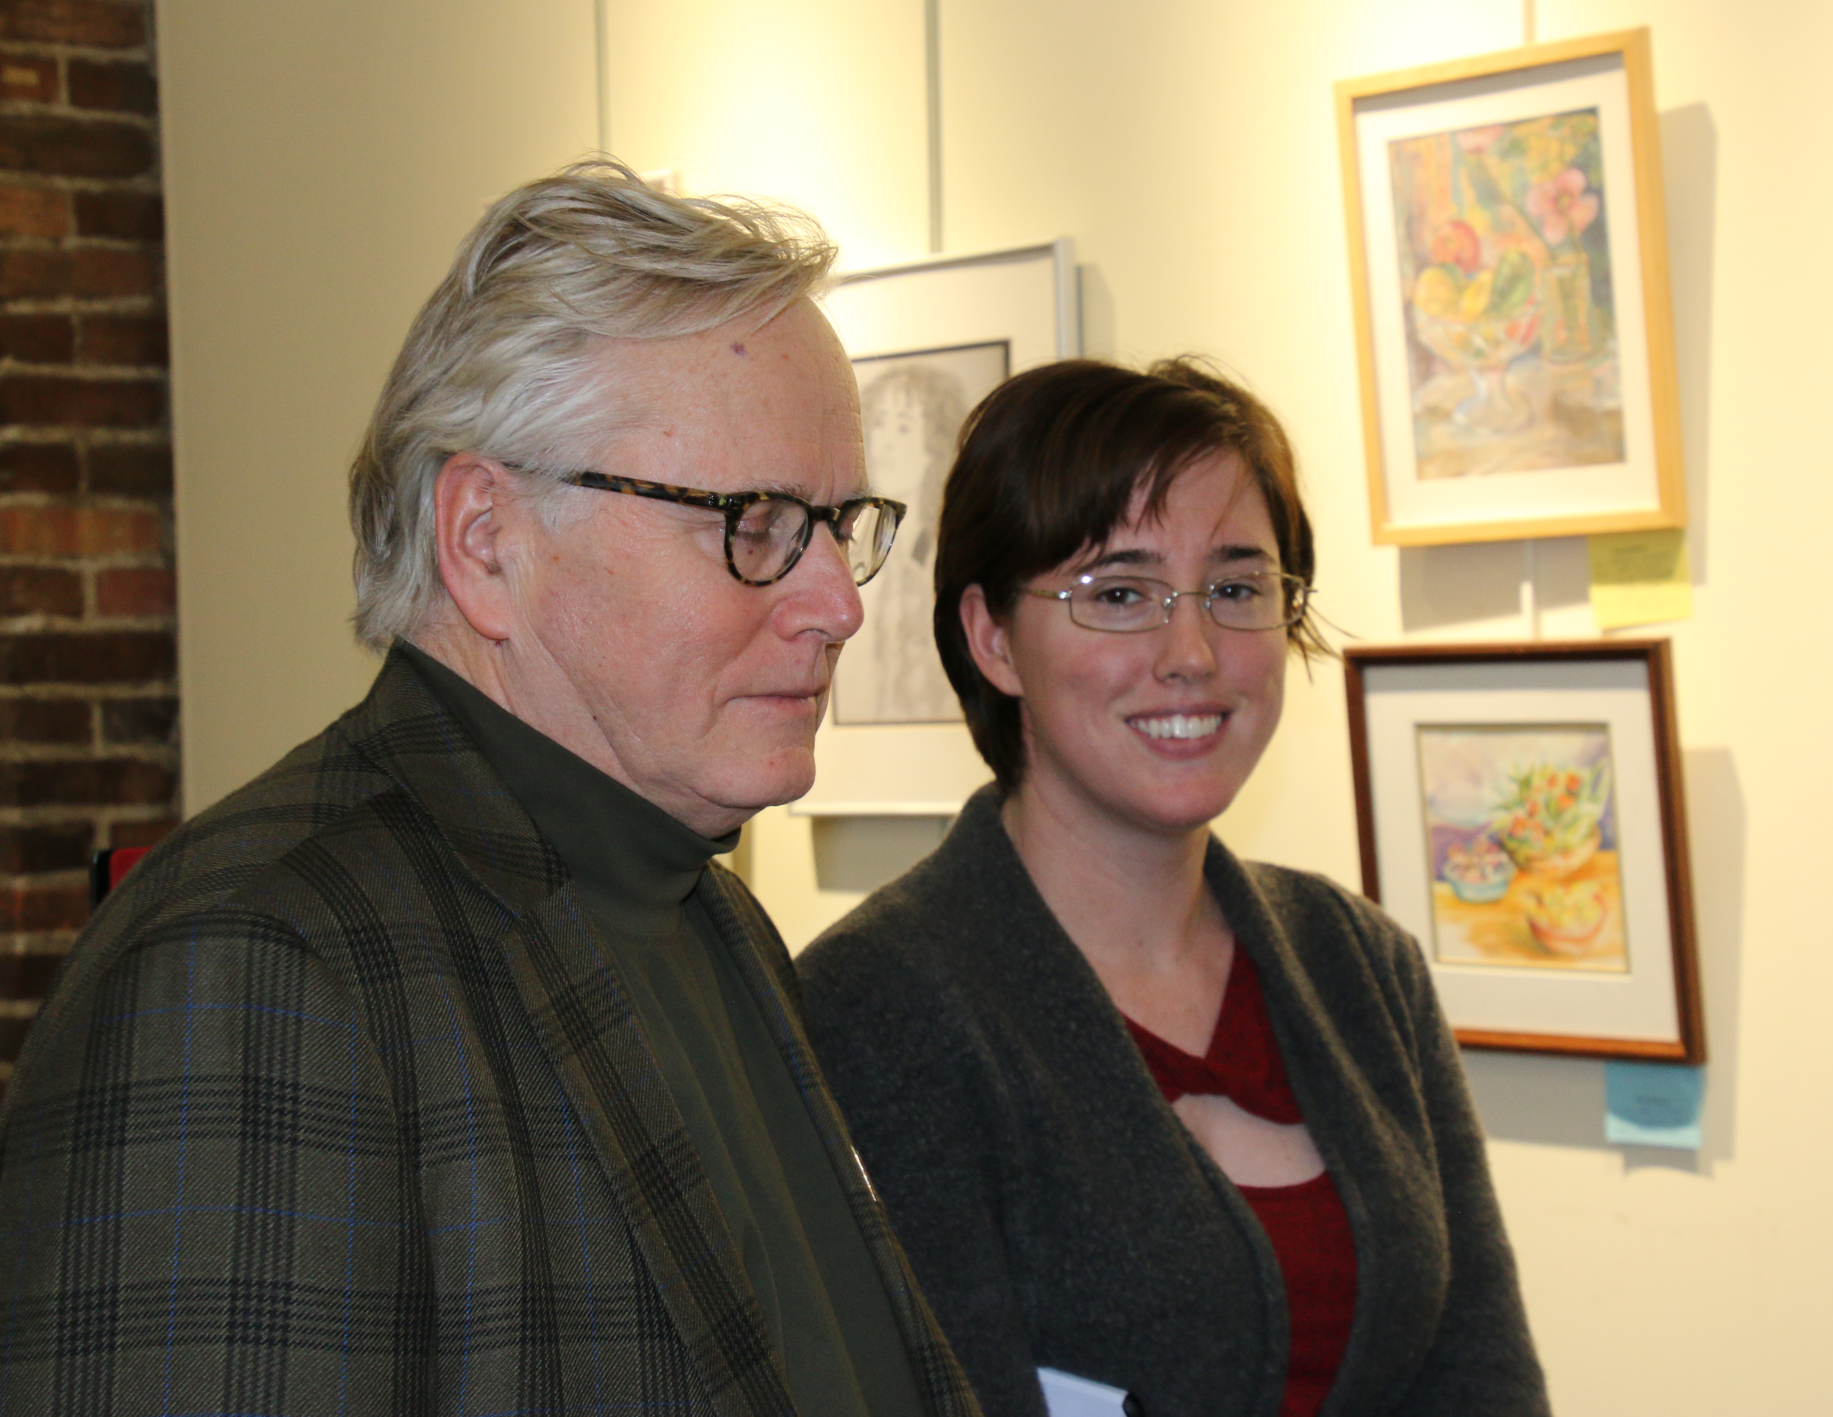
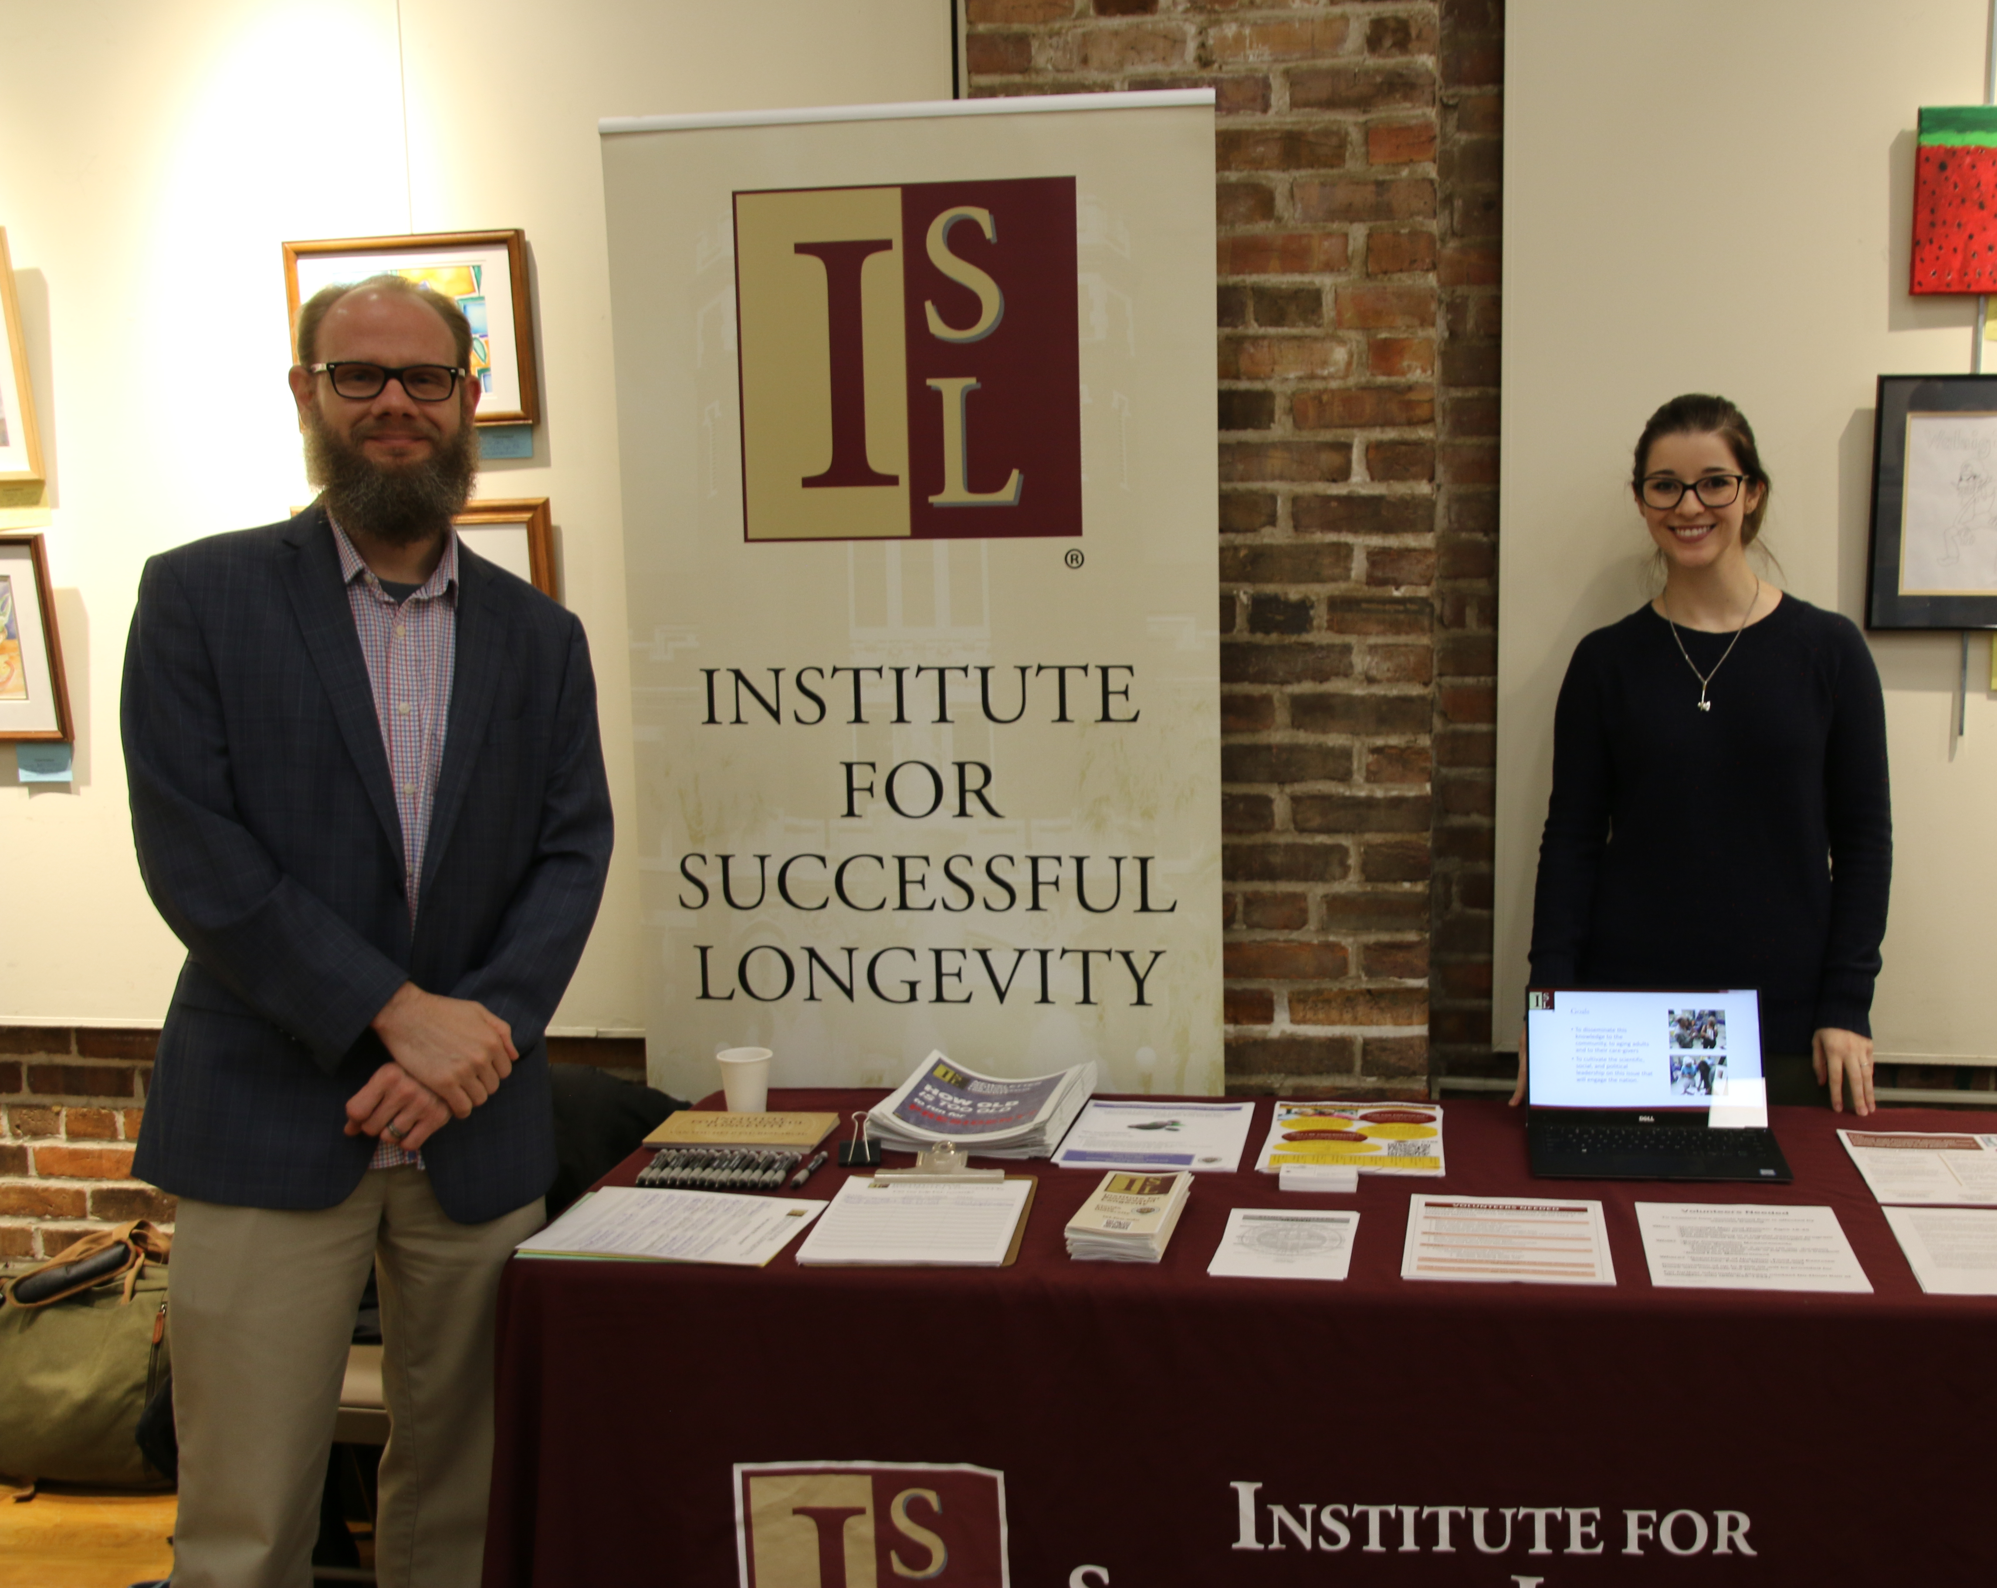
ISL at Active Living Expo

Slide 8
Awards, Honors/Promotions
Let us know if you’ve received any changes in tenure status, promotions, or received any awards!

Slide 9
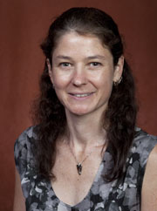
Please Congratulate Angelina Sutton
Please congratulate Angelina Sutin, promoted to full professor!

Slide 10
Upcoming ISL Brown Bags
Feb 24th-12-1pm, IPE Journal Club, hosted in COM Building, Room 4232
March 10th, Tom Broussard “Stroke Survivor & Aphasia”, PDB 211, 12pm-1pm
April 21st, Jingjiao Guan, PBD A402B, 12pm-1pm, Topic TBD, but will be discussing project that he is working on with ISL Grant award funds.

Slide 11
2020 City Wellness Conference Update
ISL is co-sponsoring event at Turnbull Center April 7, 2020
Currently searching for keynote speakers, breakout leaders
Next meeting scheduled for Feb 7th, 11am-11:30am

Slide 12
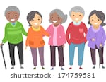
Florida Senior Day 2020
ISL will be hosting a table at the Florida Senior Day at the Florida State Capitol on Wednesday, January 29th, 2020 from 8am-3pm
Come out and support our event!

Slide 13
2020 Student Poster Research Day
Date of event: March 27th, held in Psychology Building, Atrium 2nd floor. 2pm-5pm is event time.
Good time to prime your students, get them thinking about what they would like to present at even if they are interested in attending and presenting.
This Photo by Unknown Author is licensed under CC BY-SA-NC

Slide 14
“Big Bets” Consultant Opportunity
Upcoming opportunity provided by Dr. Laurel Fulkerson to work on scaling up funding from private foundations. She would like to include ISL in the process. Might try to bring in folks from FSU Foundation too.
This Photo by Unknown Author is licensed under CC BY-NC
This Photo by Unknown Author is licensed under CC BY-SA

Slide 15
Transportation Day 2020
ISL collaborating with John Sobanjo for 2020 Transportation Day
Date is Friday April 17th, 2020

Slide 16
ISL 2020 Spring Speaker
We agreed to collaboration with Pepper Institute on Aging and Public Policy to support the visit by Karen Fingerman, an inaugural Dempsey Barron lecturer on April 2nd with lecture scheduled for 3-4pm on April 3rd in Broad Auditorium.
ISL sponsoring reception for event.

Slide 17
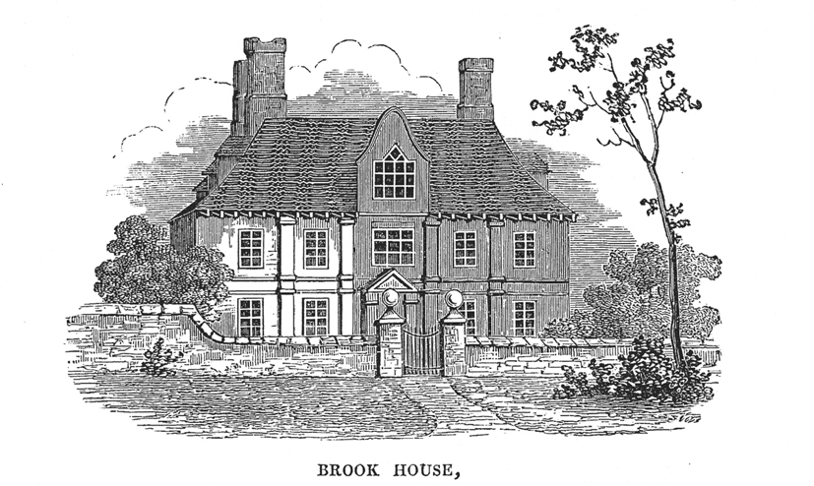
Macomb Street Manor
Affordable Senior Housing Project. Dr. Charness met with Tom Lewis of the Big Bend Community Development Corporation, hoping to get ISL involved with the development of this project.
Macomb Street Manor will embrace the concept of senior cohousing where seniors can value independent living while having the benefit of community interaction thereby creating real connections among neighbors.
This Photo by Unknown Author is licensed under CC BY-SA

Slide 18
Next Joint Advisory Board Meeting
JAB meeting scheduled for Feb 5th, 11am-12pm, PBD Room A402B
This Photo by Unknown Author is licensed under CC BY-SA-NC
This Photo by Unknown Author is licensed under CC BY-NC-ND

Slide 19
Expert Net
The Florida ExpertNet portal is where public and private enterprises throughout the world access information about Florida’s university-based research and talent. ExpertNet is a web-based knowledge management system that provides a searchable network of experts in hundreds of centers and institutes and thousands of individual faculty members all across Florida's research universities.
Potential Resource for ISL & FSU going forward.
http://cimes.fsu.edu/index.cfm/projects/11

Slide 20
Video Presentations
FSU’s Gradworld
https://gradworld.fsu.edu/graduates/
ExpertNet.org
https://expertnet.org/
Dean Mark Riley of the Graduate School explains Gradworld
https://gradschool.fsu.edu/gradworld

Slide 21
Video Presentations, continued
Some video examples — approach and quality vary
Thomas Joiner, Psychology faculty, filmed in his office — https://gradworld.fsu.edu/graduates/thomas-joiner/
Pamela L. Perrewé, College of Business, talks, with other scenes and other people brought in — https://gradworld.fsu.edu/graduates/pamela-perrewe/
Maria Anastasiou, graduate student in Physics — https://gradworld.fsu.edu/graduates/maria-anastasiou/

Slide 22
Screenshot of Grad World

Slide 23
Director’s Travel Schedule
March 5-7, CREATE Board Meeting, Ft. Lauderdale
April 8th-April 10th, University of Waterloo trip for William Forbes Lecture Series appearance.
April 19-24 CREATE workshop in Mexico City
Likely: April 24-28 CHI 2020 workshop in Honolulu

