Slide 1
Resources and Education Toward Age-Friendly Health Systems: North and Central Florida Geriatric Workforce Enhancement Program
Sponsored by the Health Resources and Services Administration (HRSA)
Paul Katz, MD, CMD
Nicolette Castagna, MA, MPH, CDP

Slide 2
Building on Success
Previous HRSA-funded GWEP: $3,000,000 from 2015-2019
Previous Projects
The Primary Care Consortium Project
Falls patient education increased from 13% to 23%
Screening for fall risk increased by over 400%
High risk prescribing decreased by almost 75%
Powerful Tools for Caregivers
114 newly certified leaders
83 workshops reaching 870 family caregivers
11 newly certified Master Trainers to train other facilitators
Senior Learning
180 medical students presented to 1272 learners at assisted living communities, senior centers, and hospitals

Slide 3
Building on Success
Previous Projects
Transforming Rural and Underserved Care Environments
Successfully established a Senior Care clinic at Friendship Health Center in Naples transforming patient care protocols, team communication, documentation, and billing
Expanded to a second Senior Care clinic establishment in Immokalee
Interprofessional Education
987 students from nursing, social work, medicine, physician assistant, and pharmacy colleges completed online interactive modules and participated in an interprofessional clinical immersion event incorporating clinical practice and lessons learned from the online modules
Nurse Workforce Enhancement Project
6 interactive online module packages developed on Pain Management in Older Adults, Influenza Prevention and Containment, Heart Attack and Stroke Recognition, and Determining Cause and Effective Treatment for Responsive Behaviors of Dementia I, II, III
500 LPNs/RNs/CNAs and WCOF staff have completed the modules

Slide 4
Their goal, our mission
College of Medicine’s unique mission:
Train physicians and physicians assistants to deliver patient-centered care responsive to community needs of elderly, rural, minority, and underserved citizens residing in Florida.
HRSA’s program goals:
Develop a healthcare workforce that maximizes patient and family engagement and improves health outcomes for older adults by
Addressing gaps in healthcare for older adults
Address the social determinants of health
Promote age-friendly health systems and dementia-friendly communities

Slide 5
The need
Unmet healthcare needs of Florida’s older adults
Unmet geriatrics education and training needs of interprofessional workforce
Challenges in leveraging community resources and creating age-friendly health systems and dementia-friendly communities

Slide 6
4Ms Framework
The John A. Hartford Foundation and Institute for Healthcare Improvement have initiated an age-friendly care movement which follows an essential set of evidence-based practices, causes no harm, and aligns with what matters to the older adult and their family caregivers. Such a health system requires reliably providing high-quality care in the 4Ms:
Mobility
Mentation
Medication
What Matters Most
Each grant project incorporates this framework into all aspects of activity – both in the clinic and community.

Slide 8
Project 1: Transforming Federally Qualified Health Centers into Age-Friendly Health Systems
Project Goals:
Transform North Florida Medical Centers’ clinical environments into integrated geriatrics and primary care systems
Expand NFMC partnerships with community-based organizations to increase care coordination between primary care sites and community sites

Slide 9
Project 1: Transforming Federally Qualified Health Centers into Age-Friendly Health Systems
Project Partners:
North Florida Medical Centers
Area Agency on Aging for North Florida
Project Impact:
Incorporate geriatric care principles and processes of care into primary care practices serving rural and underserved individuals

Slide 10
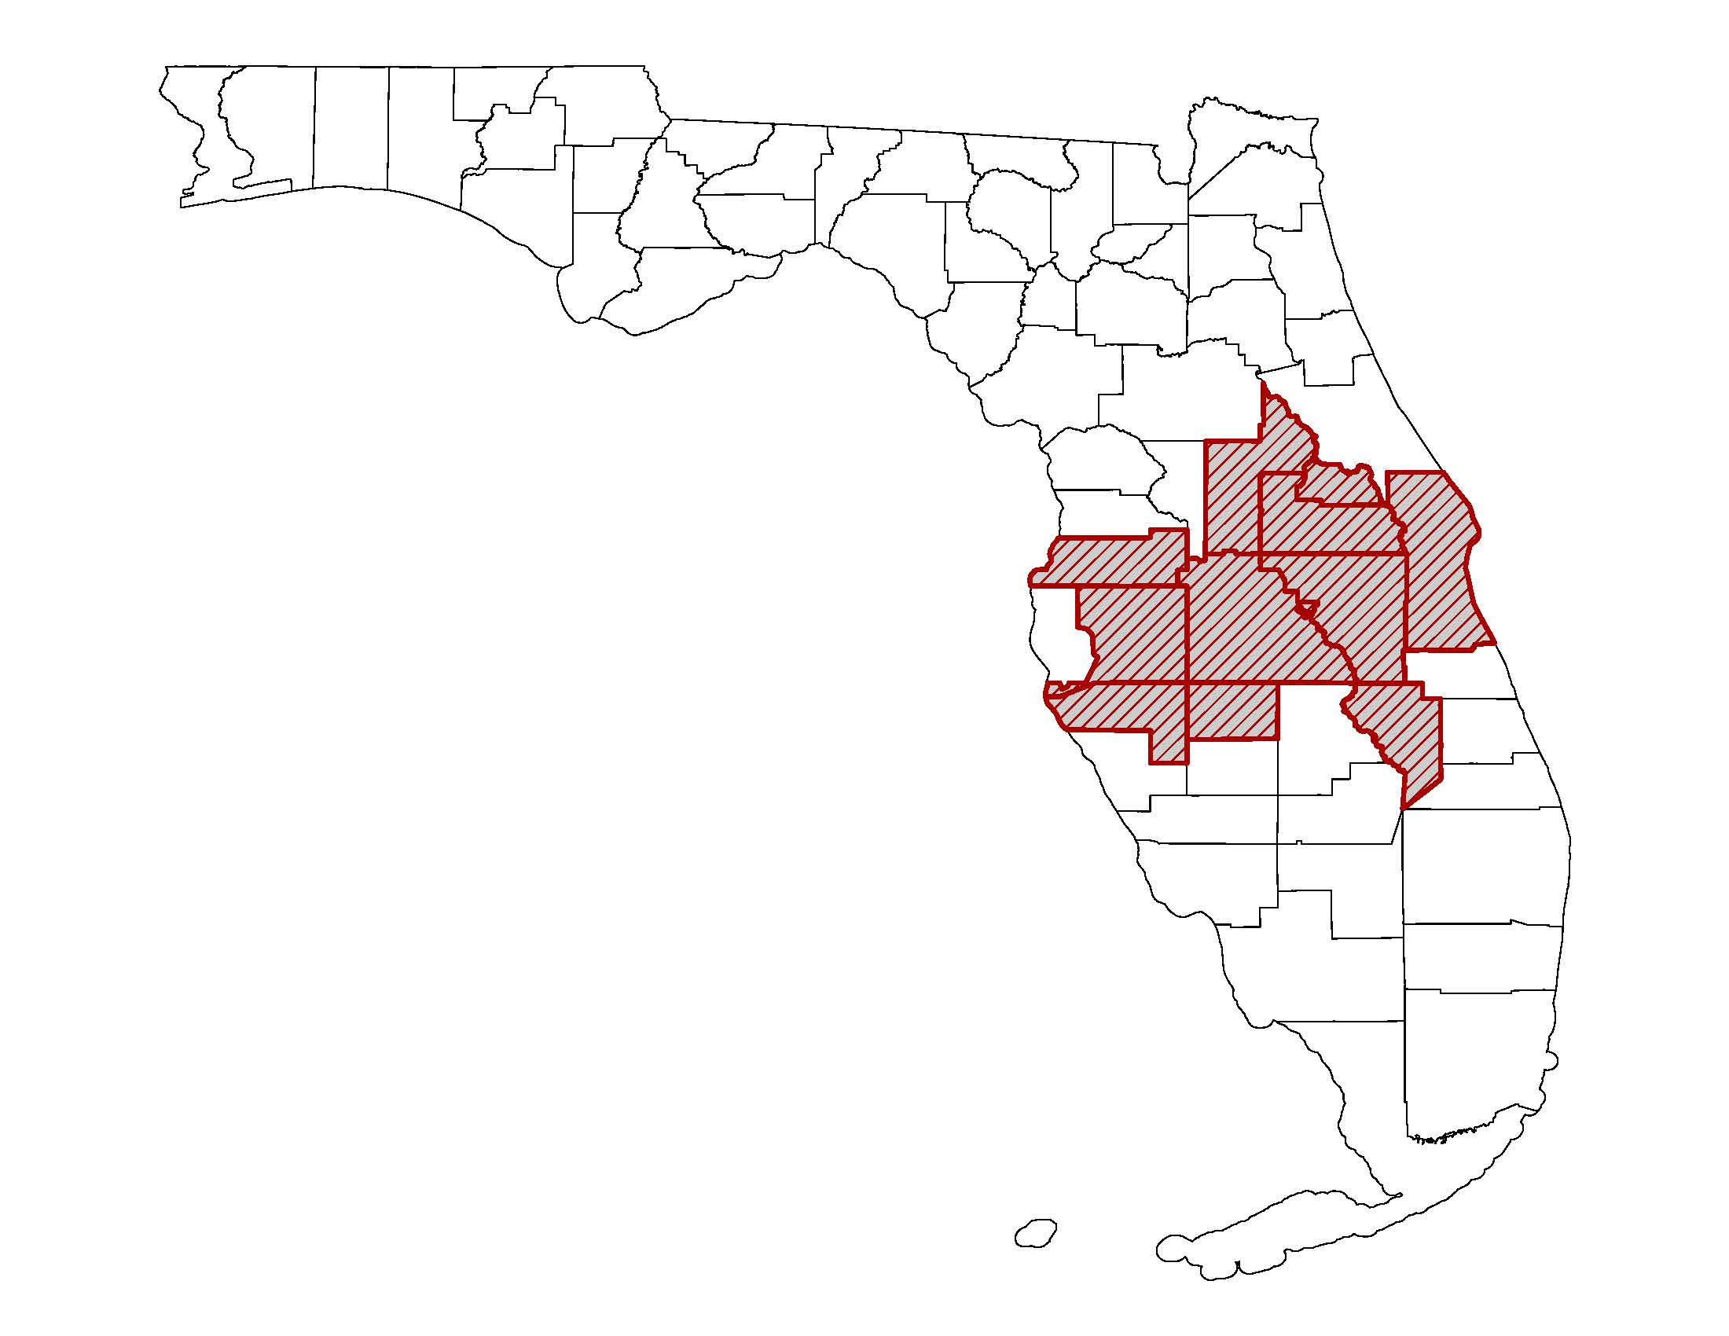
Project 2: African-American Alzheimer’s Caregiver Training and Support (ACTS2)
Project Goals:
Partner with community-based organizations to address major shortcomings in managing depression and health problems of African-American dementia caregivers in central Florida
Promote dementia-friendly communities through dementia awareness presentations to African-American faith community and elder care settings across central Florida

Slide 11
Project 2: African-American Alzheimer’s Caregiver Training and Support (ACTS2)
Project Partners:
African-American faith-based community organizations
College of Social Work
Mayo Clinic Florida
Project Impact:
Improving caregiver mental health through a culturally-sensitive cognitive behavioral intervention

Slide 12
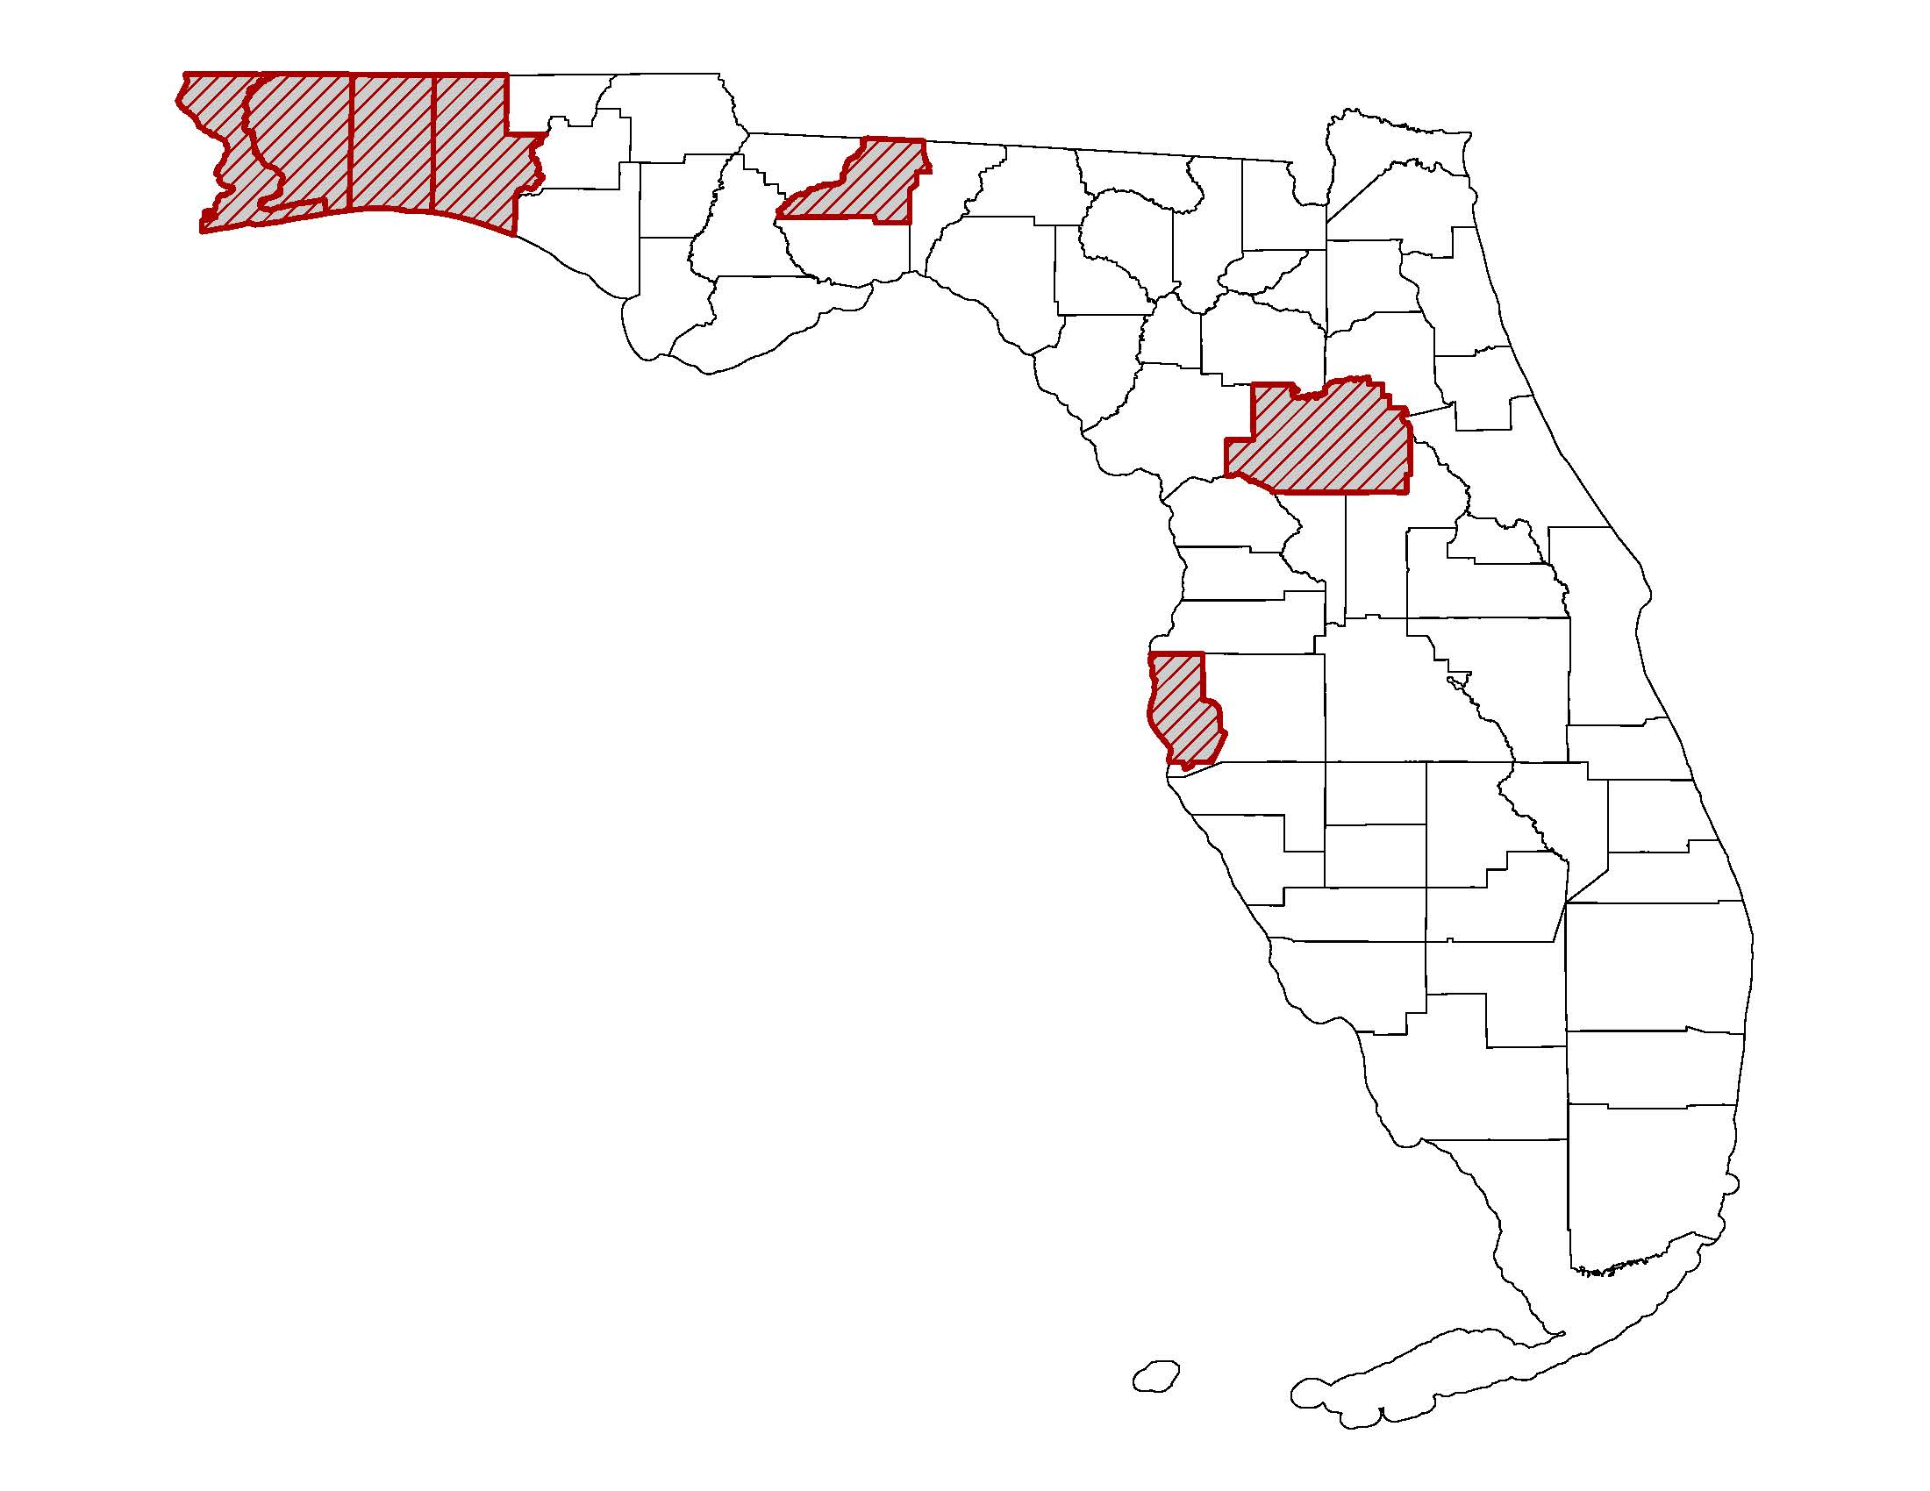
Project 3: Improving the Lives of Residents with Alzheimer’s through Montessori-Inspired Lifestyle® Training
Project Goals:
Transform assisted living facilities into patient-centered environments by training staff in Montessori-Inspired Lifestyle® for individuals with dementia
Partner with community-based organizations and state agencies to provide dementia training and educational resources to community members such as first responders and financial advisors, promoting dementia-friendly communities

Slide 13
Project 3: Improving the Lives of Residents with Alzheimer’s through Montessori-Inspired Lifestyle® Training
Project Partners:
Center for Applied Research in Dementia
Florida Department of Elder Affairs Dementia Care and Cure Initiative
Project Impact:
Training staff on patient-centered care approaches for assisted living residents with dementia

Slide 14
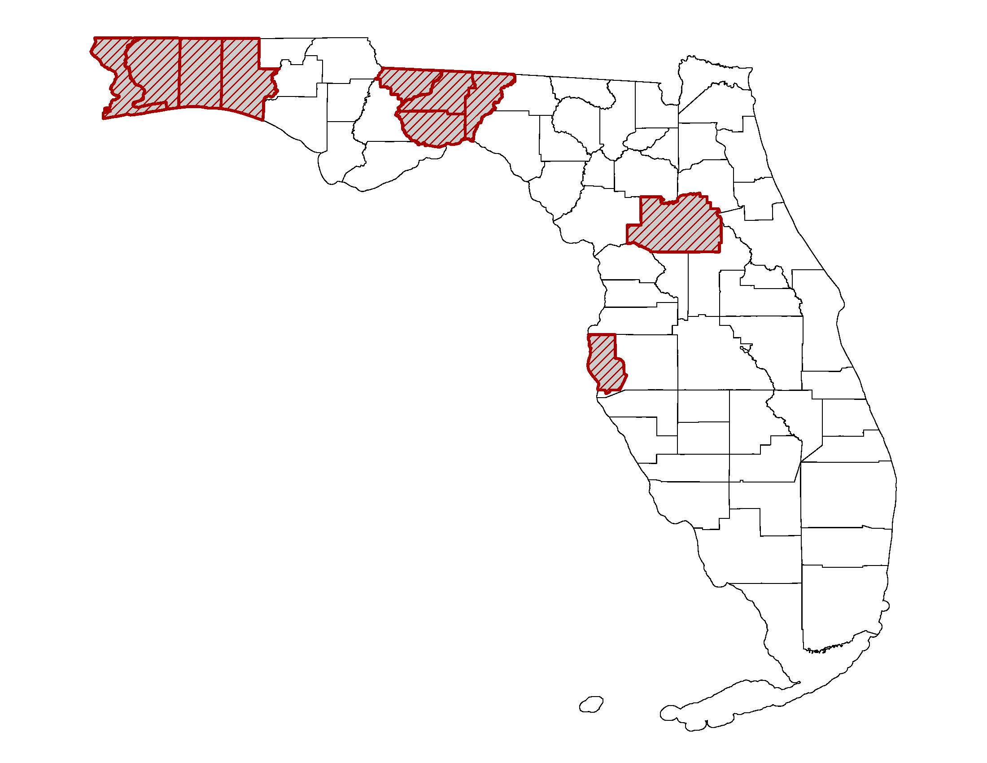
Project 4: Partnering for Quality Care: Building Effective Collaborations between Home Care Workers and the Family Members of their Clients
Project Goals:
Partner with community-based organizations to improve the quality of care for older adults by enhancing the relationship between home care workers and family caregivers

Slide 15
Project 4: Partnering for Quality Care: Building Effective Collaborations between Home Care Workers and the Family Members of their Clients
Project Partners:
Paraprofessional Healthcare Institute
Florida Pioneer Network
Home Instead Senior Care
Project Impact:
Improve relational competencies between home care workers and families by building trust and introducing creative problem-solving skills

Slide 16
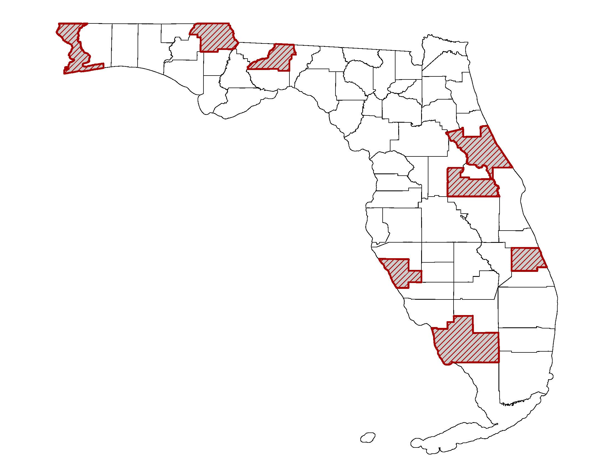
Project 5: Novel, Longitudinal Geriatrics Curriculum for Physician Assistants
Project Goals:
Educate and train physician assistant (PA) students, PA principle faculty, basic science faculty, and clinical preceptors (MD and PA) to care for older adults in integrated geriatrics and primary care models
Develop an online clinical toolbox for students and practicing clinicians that includes resources on geriatrics principles of care, geriatric syndromes, and the 4Ms to address gaps in healthcare for older adults

Slide 17
Project 5: Novel, Longitudinal Geriatrics Curriculum for Physician Assistants
Project Partners:
FSU College of Medicine School of Physician Assistant Practice
Project Impact:
Enhance physician assistant geriatric competencies through a novel, longitudinal geriatric curriculum

Slide 20
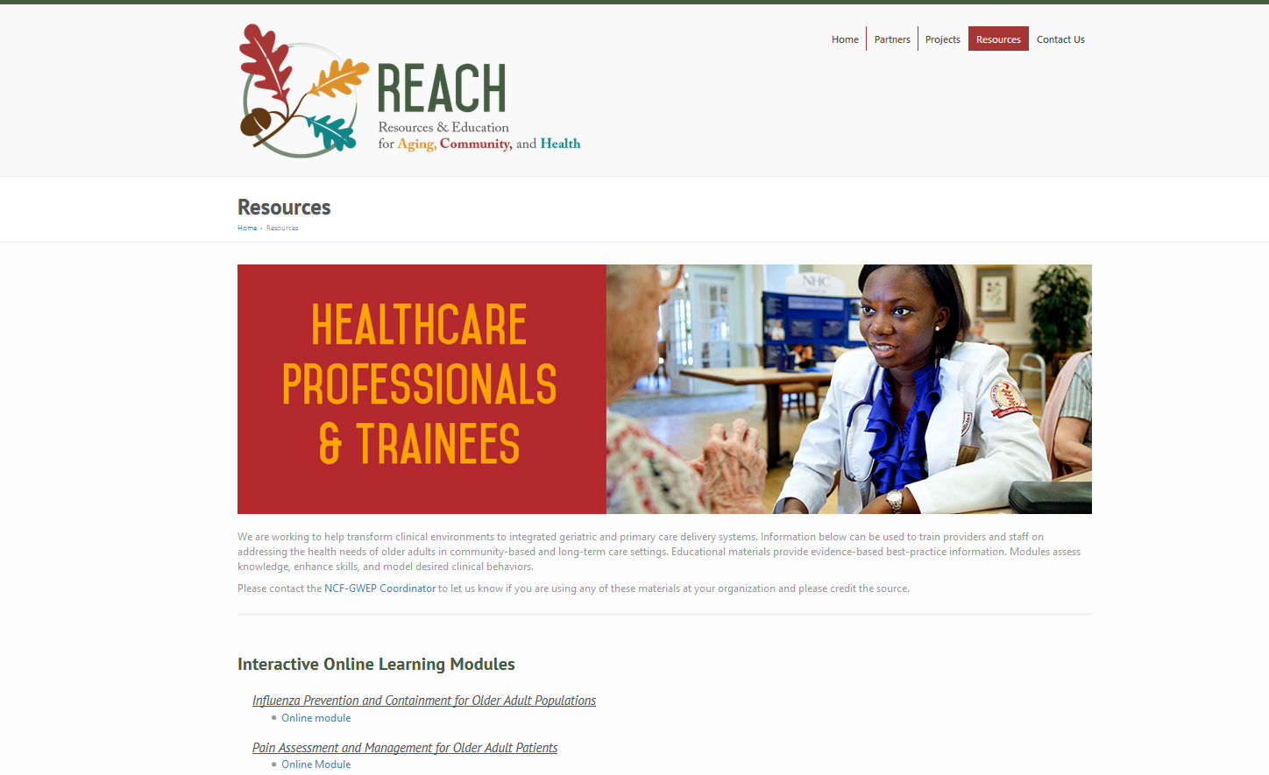

Slide 21
Community Health Resources
Interactive Online Learning Modules
Training and Quality Improvement Materials for Community-Based Health Clinics
Ready to Deliver Community-Based Presentations for Older Adult Audiences
Quick reference guides on older adults health
Brain health, Falls prevention, Advance care planning
Caregiver skill-building resources
Caregiver College skills videos
UCLA Dementia Care training videos

Slide 23
Opioid and Pain Educational Campaign
HRSA Charge:
Address opioid abuse education and training that addresses prevention, assessment, management, and/or treatment in older adults
Project Partnership:
University of South Florida School of Aging Studies & Florida Policy Geriatric Workforce Enhancement Partnership

Slide 24
Opioid and Pain Educational Campaign
Campaign Mission:
Empower people, especially older adults, to speak up about pain. By learning more about pain and how to manage it, patients and families can stay hopeful and feel confident in working with their health care team to develop a plan for the best relief.
Campaign Development:
Needs Assessment
Strategic Planning Meeting

Slide 26
