Slide 1
Institute for Successful Longevity Affiliates Meeting
Friday September 6th, 2-3pm, PDB 430

Slide 2
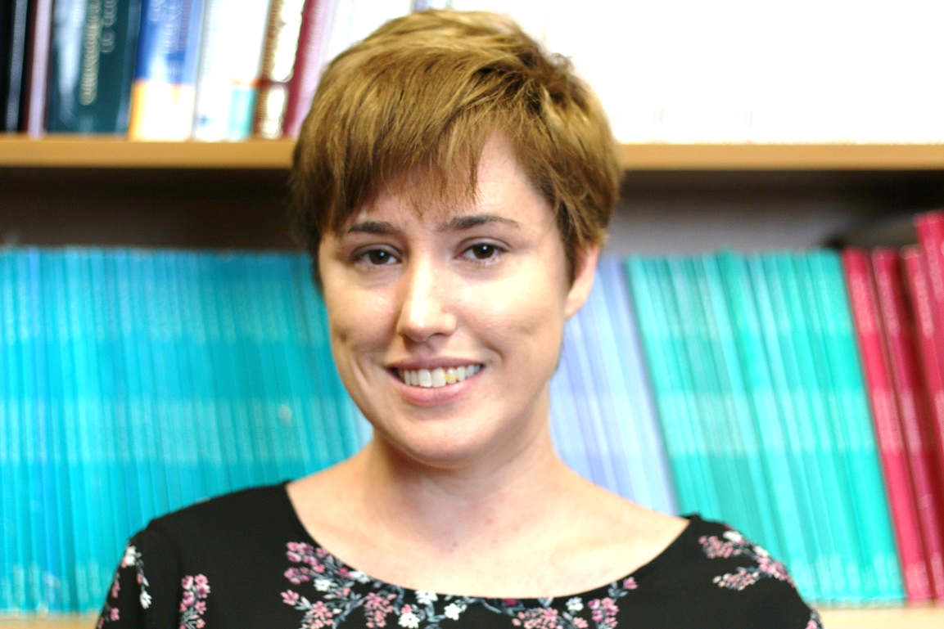
ISL JAB AGENDA
Introducing Callie Kindelsperger, ISL’s new admin assistant.

Slide 3
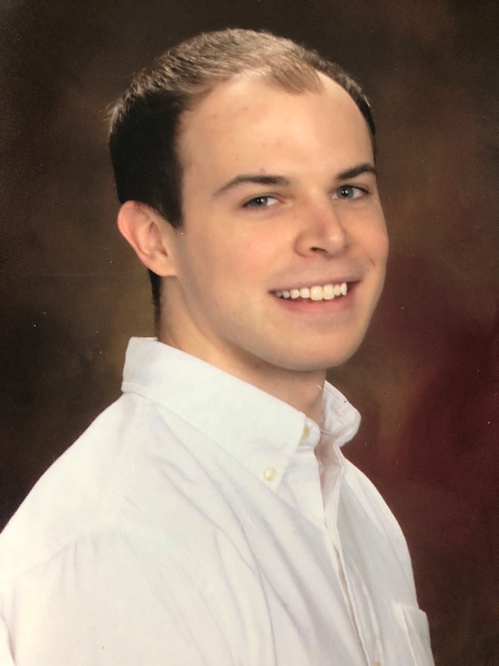
Introducing ISL New Postdoc
Nick Gray is ISL’s new postdoc.

Slide 4
Institute for Successful Longevity Grants
ISL still in the process of sending out FOA notices.
Grants Applied for and Results:
i. ERC (failed)
ii. STC – preproposal submitted
iii. R01 headed by Boot; he responded to reviewers for program officer and was funded (Boot, Chakraborty, Charness, Carr, Teracciano, Lustria, He).
iv. CREATE V submitted
v. NIDILRR submitted

Slide 5
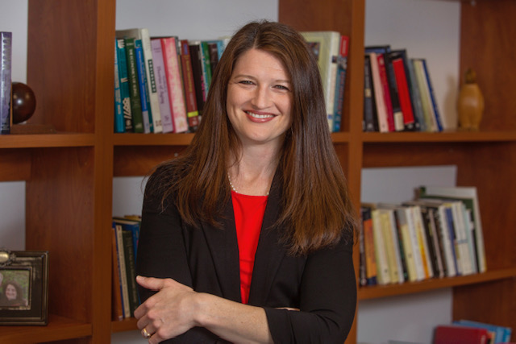
Congratulations to Dawn Carr
Promoted to Associate Professor with tenure!

Slide 6
Congratulations to Wally Boot!
Promoted to full professor!

Slide 7
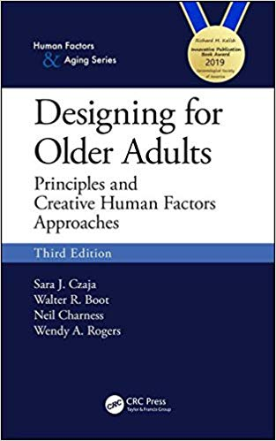
Award Announcements
CREATE book, Designing for Older Adults (third edition) is receiving the 2019 Richard Kalish Innovative Publication Award from the Gerontological Society of America.

Slide 8
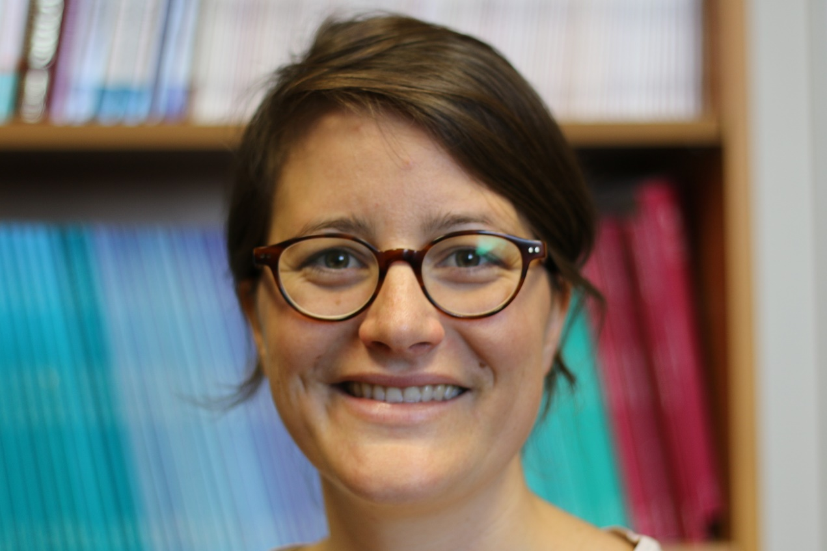
July 16-25 Prof. Schlomann Visit
Visiting Professor Anna Schlomann (Aging and Technology Interests) visited FSU/ISL July 16-25

Slide 9
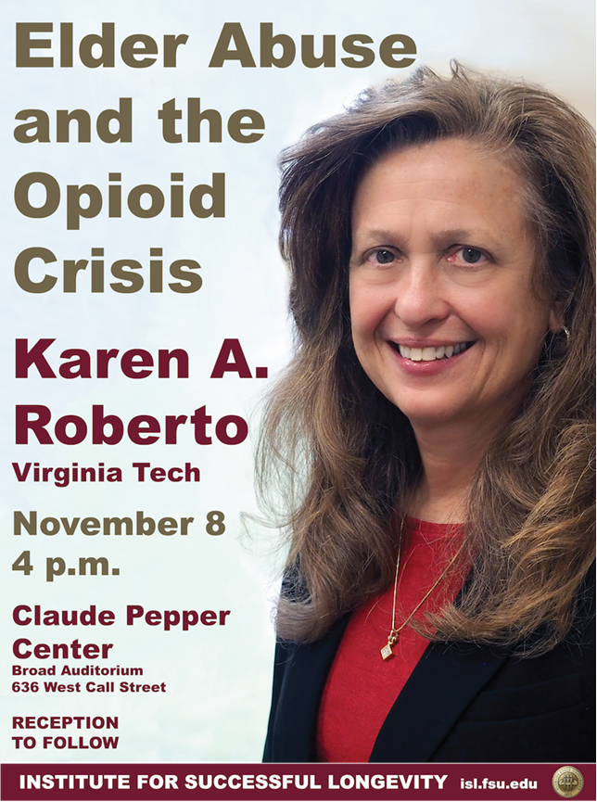
ISL Lecture Series Fall 2019 Speaker
Dr. Karen Roberto is ISL’s Fall 2019 Speaker.
“Elder Abuse and the Opioid Crisis.”
Nov. 8th, 4:00pm, Claude Pepper Center.
Community Panel on this topic of discussion to be held Thurs. Nov 7th 2pm at Killearn United Methodist Church, Fellowship Hall
Karen Roberto, Alice Pomidor, Lauchlin Waldoch are the panelists.

Slide 10
Dinner with Dr. Roberto?
She will be available for both Thursday and Friday nights. Please let us know if you would like to attend and also if you want to have an individual meeting with her Friday morning or early afternoon
Remind your students about a graduate student lunch with her on Friday at noon and RSVP so that we have a rough count

Slide 11
Upcoming ISL Brown Bags
Monday Sept 9th – IPE Journal Club, 12 – 1 pm
Monday, October 28th – ISL brown bag lecture, 12 – 1 pm
Monday, November 25th – ISL brown bag lecture, 12 – 1 pm
Monday December 9th – IPE Journal Club, 12 – 1 pm

Slide 12
ISL Spring Brown Bags
Need ideas for topics? Suggestions?

Slide 13
Agenda Items
Entrepreneurial Senior Design meeting with Mike Devine & colleagues scheduled around Design for Cognitive Impairment.
Monday Aug 19th 2:00-3:00pm, PDB Room 223.
(update meeting with results after meeting over)-CK.
City Wellness Conference was held on Aug. 16th with Brian Smatt to discuss wellness & retirement conference jointly sponsored by City of Tallahassee, Senior Center, & ISL.
Conference looking to be held on April 7th, 2020.
Details still being arranged.
ISL will have a table at the event.

Slide 14
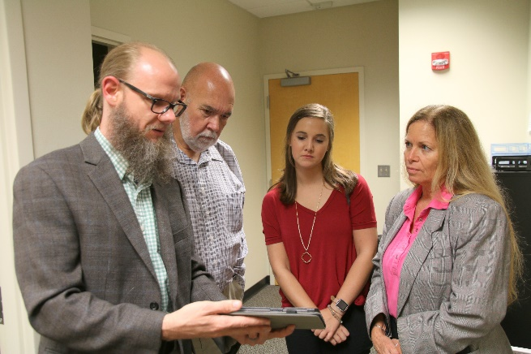
Meetings with Federal Representatives
APA has been supporting visits to labs from Congress staff representatives to build support for behavioral science
Wally Boot made a visit to the Hill when in DC
Boot & Charness met with representatives from Rubio’s and Dunn’s staff, alerting Jonathan Nurse, FSU’s lobbyist
8/6 with Josh Gabel
8/16 with Will Kendrick, Meghan Myhill, Amanda Daughtry

Slide 15
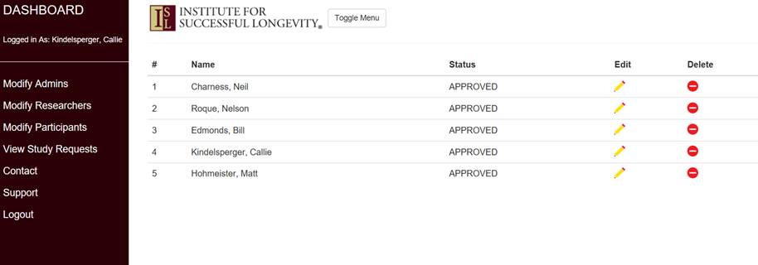
Resources for Affiliates
Participant Registry containing ~2700 volunteers age 60+
Interdisciplinary planning grant program with applications due in April 2020
Media coverage
Please let Bill Edmonds know when you do interviews, press releases, and please mention ISL where appropriate

Slide 16
Agenda Items
Charness Travel Schedule
Sept. 12-15: CREATE PI meeting (book writing) in Stowe, Vermont
Sept. 22-24: FDP meetings in Washington, DC.
Oct. 2-5: Tech, Mind & Society APA symposium in Washington, DC
Oct. 20-22: CREATE Workshop, NYC
Nov. 12-17: GSA meetings in Austin, TX; FSU-Penn State Reception Friday 15, 8-10pm Central in JW Marriott, Lonestar Ballroom D (level 3)
Dec. 10-12 National Academies Workshop, DC

