Slide 1
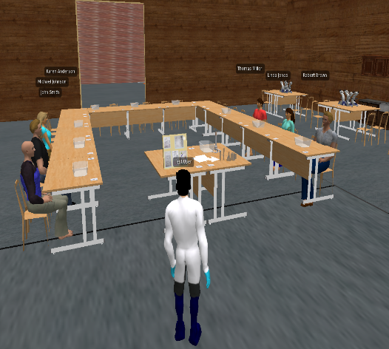
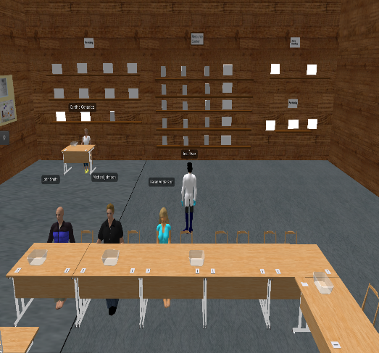
~Hone Your Skills in Orchestrating Science and Math Class Discussions~
Virtual World Simulations
with A.I. Students
Do you want to enhance your teaching knowledge and skills? This is a rare opportunity to exercise your teaching muscles in a consequence-free virtual world with AI-powered students!
Work with AI-powered virtual students
Conversational virtual students allow you to cultivate teaching knowledge and skills in discourse-rich, authentic settings.
We focused on “Eliciting ideas” and “Consensus building” of the 5E learning cycle so you can practice challenging and under-practiced components.
Engage in challenging teaching practice
Learn in a comprehensive program
Besides honing your skills in orchestrating science and math class discussions, you will receive a $30 gift card at the end of the study.
Study information:
This study involves 4 hours of virtual classroom teaching for math & science pre-service teachers. The results will inform training practices involving virtual world simulations.
Signup today! Go to:
Contact:
Professor Fengfeng Ke
Email: fke@fsu.edu
Educational Psychology & Learning Systems
College of Education
Florida State University
shorturl.at/nPU15
or scan QR code to sign up in Qualtrics!

