Slide 1
7Th Annual Rural summit
“Violence Against Children in a Modern Society”

Slide 3
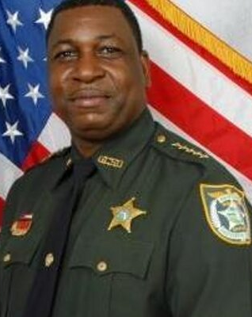
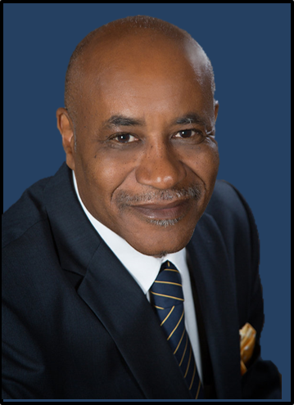
7th Annual Rural Summit
The Rural County Summit is designed to give our leaders in the community the best opportunity to be successful in the most tragic situations. Each year we have highlighted different types of events to make sure that we are focusing on the hottest topics. This year, we will discuss Violence Against Children in a Modern Society. This year, the Rural Summit is focusing on our children’s safety. Our children deserve to have the most informed and prepared leaders possible as we struggle to keep them safe in this changing society. The Marjory Stoneman Douglas and Sandy Hook School Shootings are two of the most horrific events in recent U.S history. As an attendee you will hear leaders who were directly involved in the shooting or aftermath and tell you in detail about the event. The FBI and FDLE will teach us about the modern dangers that our children face through technology. Many of us who are older are unaware of the issues that our children face from these predators who seek our children through technology. Mental health and social stress among youth is at an all-time high. Experts will explain how this effects our children, how you can recognize, and how to help children facing these terrible issues.
SHERIFF MORRIS A. YOUNG
SUPERINTENDENT ROGER MILTON
To register please send email to Ruralcountysummit@tds.net or call Major Shawn Wood (850) 5194295

Slide 4
Marjorie Stoneman Douglas School Shooting
First, I would like to honor and recognize the 17 people who lost their lives in the Marjory Stoneman Douglas School Shooting. On February 14, 2018 an ex-student entered the school and began an onslaught that would cause 17 innocent people to lose their lives. As an attendee, you will hear the details of this tragic event told by Sheriff Bob Gualtieri, Chairman of the Marjory Stoneman Douglas Commission.
Marjory Stoneman Douglas Heroes

Slide 5
Marjory Stoneman Douglas Commission
Sheriff Bob Gualtieri, Chairman of the Commission, will give an in-depth review of the shooting incident at Marjory Stoneman Douglas in Parkland, Florida. Sheriff Gualtieri led this collaborative panel through one of the most comprehensive investigations, produced findings in unprecedented time, and give safety action plans for every school in the State of Florida. Sheriff Gualtieri will provide the insight provided by this tremendous panel.
The Marjory Stoneman Douglas High School Public Safety Commission within the Florida Department of Law Enforcement was established during the 2018 legislative session. The legislation represents a comprehensive approach to identifying and addressing issues presented by the tragedy that occurred at Marjory Stoneman Douglas High School in Parkland, Florida. The Commission was formed to specifically analyze information from the school shooting and other mass violence incidents in the state and address recommendations and system improvements.
SHERIFF BOB GUALTIERI
Pinellas County

Slide 6
Sandy Hook School Shooting (7 Years Later)
SRO William Chapman began his law enforcement career in 2008 with the Newtown Police Department. After only four years on the job, one of the worst school shootings in history took place in his community. The Sandy Hook School Shooting shocked the world as society began to look at the vulnerability of our children.
SRO Chapman will give his first hand experience in both the immediate response and aftermath of one of the most horrific incidents in modern American history. Chapman will give insight on how to enhance physical security of the classroom and the social/emotional security of the students and staff.
Attendees will hear the story from within about how it happened and how difficult it was after such a tragic event occurred in his community. Chapman will explain why there is such value in a relational approach to school safety and security.
“SRO Chapman truly has a story of tragedy that will be difficult to hear. The Sandy Hook Story is tragic, but the efforts by those who responded and the aftermath is nothing less than heroic. He will explain the difficulties of trying to live past such a tragic moment for the students, staff and responders who dealt with such heartbreaking story.”
-Major Shawn Wood
SRO William Chapman
Newtown Police Department

Slide 7
Sandy Hook School Shooting (7 Years Later)
(CNN) It remains among America's most heinous nightmares: the lives of 20 little children -- dancers and swimmers, pianists and painters, budding readers, little sisters and big brothers -- extinguished in a flash of violence inside Sandy Hook Elementary.
Taken with them on that chilly Friday in December -- just 11 days before Christmas -- were six adults felled by the same gunman as they refused to abandon their sacred trust to safeguard the smallest among them.
Five (talking about 5 or 7 years later?) years later, even those who have never set foot near Newtown, Connecticut, can conjure the scene painted by police of a first-grade classroom transformed into a killing field. You can see the faces of anguished parents desperate for proof of life, then later, tiny caskets overloaded with stuffed animals never to be named.
Since the 2012 massacre, a new school has been built for the students of a town known, now and for years to come, as a cradle of sorrow -- but also as the home of quiet resilience and untold love.
The 12 girls, eight boys and six women whose futures were stolen that day will be remembered, always. Here is a glimpse of what we learned about them in the days after they were lost:
7 years after Sandy Hook victims
“Are Not Forgotten”

Slide 8
“The Amanda Todd Story”
On September 7, 2012, Amanda posted a 9-minute video on You Tube titled “My Story: Struggling, Bullying, Suicide and Self-harm.” This story moved me along with millions of others around the world. Today over 50 million views of the video have been seen. A child motivated me to learn more about how something could happen to such a beautiful child (“child” twice in sentence sounds redundant). Amanda brought bullying to the forefront across the world.
This was a story that I didn’t want to go away, so I searched Canada for someone to tell the story. While looking, I was able to track down Carol Todd, her mother. Through our conversations about Amanda, I knew that every individual in charge of a child’s life should hear this story. I was moved by a child I never knew.
Amanda Todd

Slide 9
“The Amanda Todd Story” Told by Carol Todd
Carol Todd, a school teacher, will tell the amazing story of how such a beautiful child could not face the pain of bullying by her peers and took her own life. A child who had the world to live for felt no way out. Carol has made bullying her life’s mission in honor of her daughter and tells her story in hopes of changing those who care for children.
The Amanda Todd Legacy Foundation was started by Carol Todd in memory of her daughter. Carol has been the key note speaker around the world telling Amanda’s Story.
As a lifelong educator, Carol will tell the story from both sides, mother and educator. Carol’s background as an educator has provided the insight to school systems around the world.
Carol Todd’s drive to teach the world about bullying is an amazing testament to the love of a mother. I am in awe and this story will motivate you to help eradicate bullying.
Carol Todd
“Amanda Todd’s Mother”

Slide 10
FBI: Sextorting “Largest Case in U.S. History ”
The FBI out of Jacksonville will present the largest sextorting case in American history. A 30 year old subject living in North Florida victimized up to 350 victims (“victimized victims” is redundant). The FBI will explain how cell phone images have been stolen and displayed around the world.
The FBI will explain how iPhones can be compromised and place children in danger. “That Smartphone has a camera, it has the ability to broadcast a child’s location. It has the ability for a stranger to gain entry into your child’s bedroom via video chat, texting, taking still pictures.” -FBI Agent Macdonald
“Education prevents children from being victimized and the more people we can educate on this, the fewer child victims we’ll have.” -FBI Agent Macdonald

Slide 11
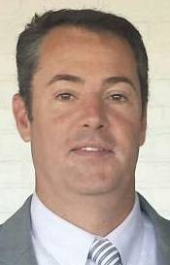
Danger for Children in a Digital World Florida Department of Law Enforcement
Special Agent Supervisor Mike Duffey is a graduate of Florida State University with a degree in Criminology and attended his basic police certification at Pat Thomas Law Enforcement Academy in 1994. He began his law enforcement career with the Tallahassee Police Department as a patrol officer then eventually moving to the street crimes unit working primarily with street narcotic sales.
In 2003, Special Agent Supervisor Duffey joined FDLE in the Computer Crime Center. Since joining the Computer Crime Center in 2003 Inspector Duffey has been involved in computer crime cases that involved fugitives, gangs, domestic security, homicides, fraud, network intrusions, BOT Networks and Internet Crimes Against Children investigations. In 2004-2007 Inspector Duffey worked with the Department of Children and Families to secure funding to combat online child exploitation.
Special Agent Supervisor Duffey has also worked with the National Center for Missing and Exploited Children on issues surrounding online child exploitation on a national level. Special Agent Supervisor Duffey is currently oversees all computer related crime investigations statewide for FDLE along with continuing to grow FDLE’s efforts in the cyber field.
Special Agent Supervisor Duffey is an instructor in the area of Online Child Exploitation for the Department of Justice and the Internet Crimes Against Children Task Forces and is recognized as an expert in State and Federal court in the area of Computer Crimes and Online Child Exploitation investigations.
Agent Mike duffey
Special Agent supervisor

Slide 12
DOE: Florida Safe Schools
The Florida Department of Education Office of Safe Schools will provide the best practices, training standards and oversight of school safety and concerns. This presentation will discuss the issues that are being faced from across the State of Florida. The evolution of technology has created so many positives in our educational process, but it has also provided issues for schools, responders, parents and children across the state.
Mental health among our youth is a growing concern. The Florida Department of Education has pushed the AWARE program throughout the state. Currently we are seeing a 1 out of 5 adolescents facing mental health issues. The product of understanding what is going on and how early of an issue we are seeing with the onset. It will also be good for first responders to hear the issues that children are facing in the schools. The old saying what happens in the school carries over into the community, and what happens in the community carries over into the school.
Bullying is truly one of the biggest issue and concerns for our youth in today's society. The latest and greatest efforts will be talked about in an effort for attendees to understand the best practices in this type of problem. The Amanda Todd Story will be told prior to the presentation and hopefully this will help leaders in attendance to better understand the severity of this issue.

Slide 13
DOE: Florida Safe Schools
Brooks Rumenik began her professional career as an elementary classroom teacher in the early 90’s and has maintained a strong passion for fostering the social and emotional well-being of students as an integral part of their academic success. After a decade in the classroom, her work led her to the Florida Department of Education’s (FDOE) Office of Safe Schools, providing technical assistance and support to school districts for substance abuse and violence prevention efforts. In 2006, Mrs. Rumenik was recognized by the Florida Office of Drug Control as one of the Who’s Who of Prevention Leaders in Florida.
Among other statewide areas of focus, she prioritizes efforts that include bullying prevention and creating positive school climates in schools. She currently serves as the Deputy Director of FDOE’s Office of Safe Schools and works to support school districts to ensure safe and supportive learning environments for all students and staff across Florida, focusing on prevention, intervention and emergency preparedness planning.

Slide 14
Crime Prevention Through Environmental Design
Jay Toth is a 35-year veteran of law enforcement and instructor of numerous workshops, seminars and classes. The last half of his career has been spent specializing in crime prevention and school resource officer programs. Prior to his recent retirement as a Lieutenant from the Volusia County Sheriff’s Office, Jay was assigned as a Sergeant in the Community Services Section. In addition to crime prevention, Jay supervised the school resource deputy program and was part of the school security assessment team providing security surveys, reviews, law enforcement services and training to the school district.
Jay is currently an instructor for crime prevention and school resource officer programs on the state, national and international level.
Jay is a member of the Florida Design Out Crime Association and the Florida Crime Prevention Association. He holds his Florida Crime Prevention Practitioner, Florida School Resource Officer Practitioner, and Crime Prevention Through Environmental Design Practitioner designations through the Florida Office of the Attorney General’s Florida Crime Prevention Training Institute.
Ret. Lt. Jay Toth
Volusia County Sheriff’s Office

Slide 15
7th Annual Rural County Summit “Moderator”
Chief David Perry is recognized nationally as one of the top experts in school safety. Chief Perry has been noted as one of the pioneers in the changing narrative of school safety in the last decade from his implementation of mass notification systems to his leadership in the movement of dangerous situations for students.
Chief Perry also brings leadership during school related disasters from the decades of being a manager (manager of what?) when tragic events occurred. His experience and quality of actions has also made him one of the first experts to be called upon when tragic events occur in a school related event across the county.
Truly one of the pioneers in the modern safety of schools, Chief Perry has began his career as an educator at the college level and to other administrators across the country. Known as a leader, he now is one of the premier instructors to future leaders.
Chief david Perry
Florida State University

Slide 16
7th Annual Rural County Summit “Moderator”
Ret. Undersheriff Steven Harriett began his career in 1974 at the Sanford Police Department. After years of service Harriett was promoted to Chief of Police for the City of Sanford. In 1993 Harriett became the Undersheriff of the Seminole County Sheriff’s Office.
In his 42 years of service, Undersheriff Harriet has managed many high profile tragic events. The ability to relate with his community and understanding of how important relationships are has allowed him to be a successful leader of his community during tragic times.
After a successful 42 year career, Harriett was hired by the Florida Sheriff’s Association to direct training for deputies in the State of Florida. During his tenure as the FSA Director of Training, Harriett has pushed leadership training to future leaders across the State of Florida. New mindsets and servant leadership is Harriett’s goal to those who serve and protect our communities.
As the FSA Training Director, Harriett will provide insight to the training needs of leadership who are responsible for the safety of our children
Ret. Undersheriff
Steven Harriett
Florida Sheriff’s Association

Slide 17
Gadsden County School District
35 Martin Luther King, Jr. Blvd - Quincy, Florida 32351 (850) 627-9651
WWW.GADSDENSCHOOLS.ORG

Slide 18
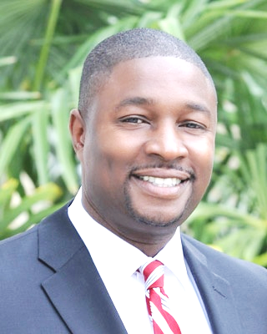
Gadsden County Board of County Commissioners
DR. ANTHONY VIEGBESIE, PHD | SHERRY TAYLOR | BRENDA HOLT | ERIC HINSON | GENE MORGAN
Chairman | Vice Chairman
9 E. Jefferson St. #B - Quincy, Florida 32351 (850) 875-8650
HTTPS://WWW.GADSDENCOUNTYFL.GOV/COMMISSION

