Slide 1
COGS Information Session

Slide 2
Committees
Student Affairs
Academics and honor policy
Parking and Transportation
Housing and Dining
Library
Health and Wellness
Social and Community Planning
Internal Affairs
Cogs monthly news letter (none?)
Updates to the website
Membership and outreach
Oversight of expenditures
Train new Cogs members
Maintain attendance records
Student Advocacy
Graduate Students pay and funding
Childcare
Relations with the Graduate Students United
Health Care

Slide 3
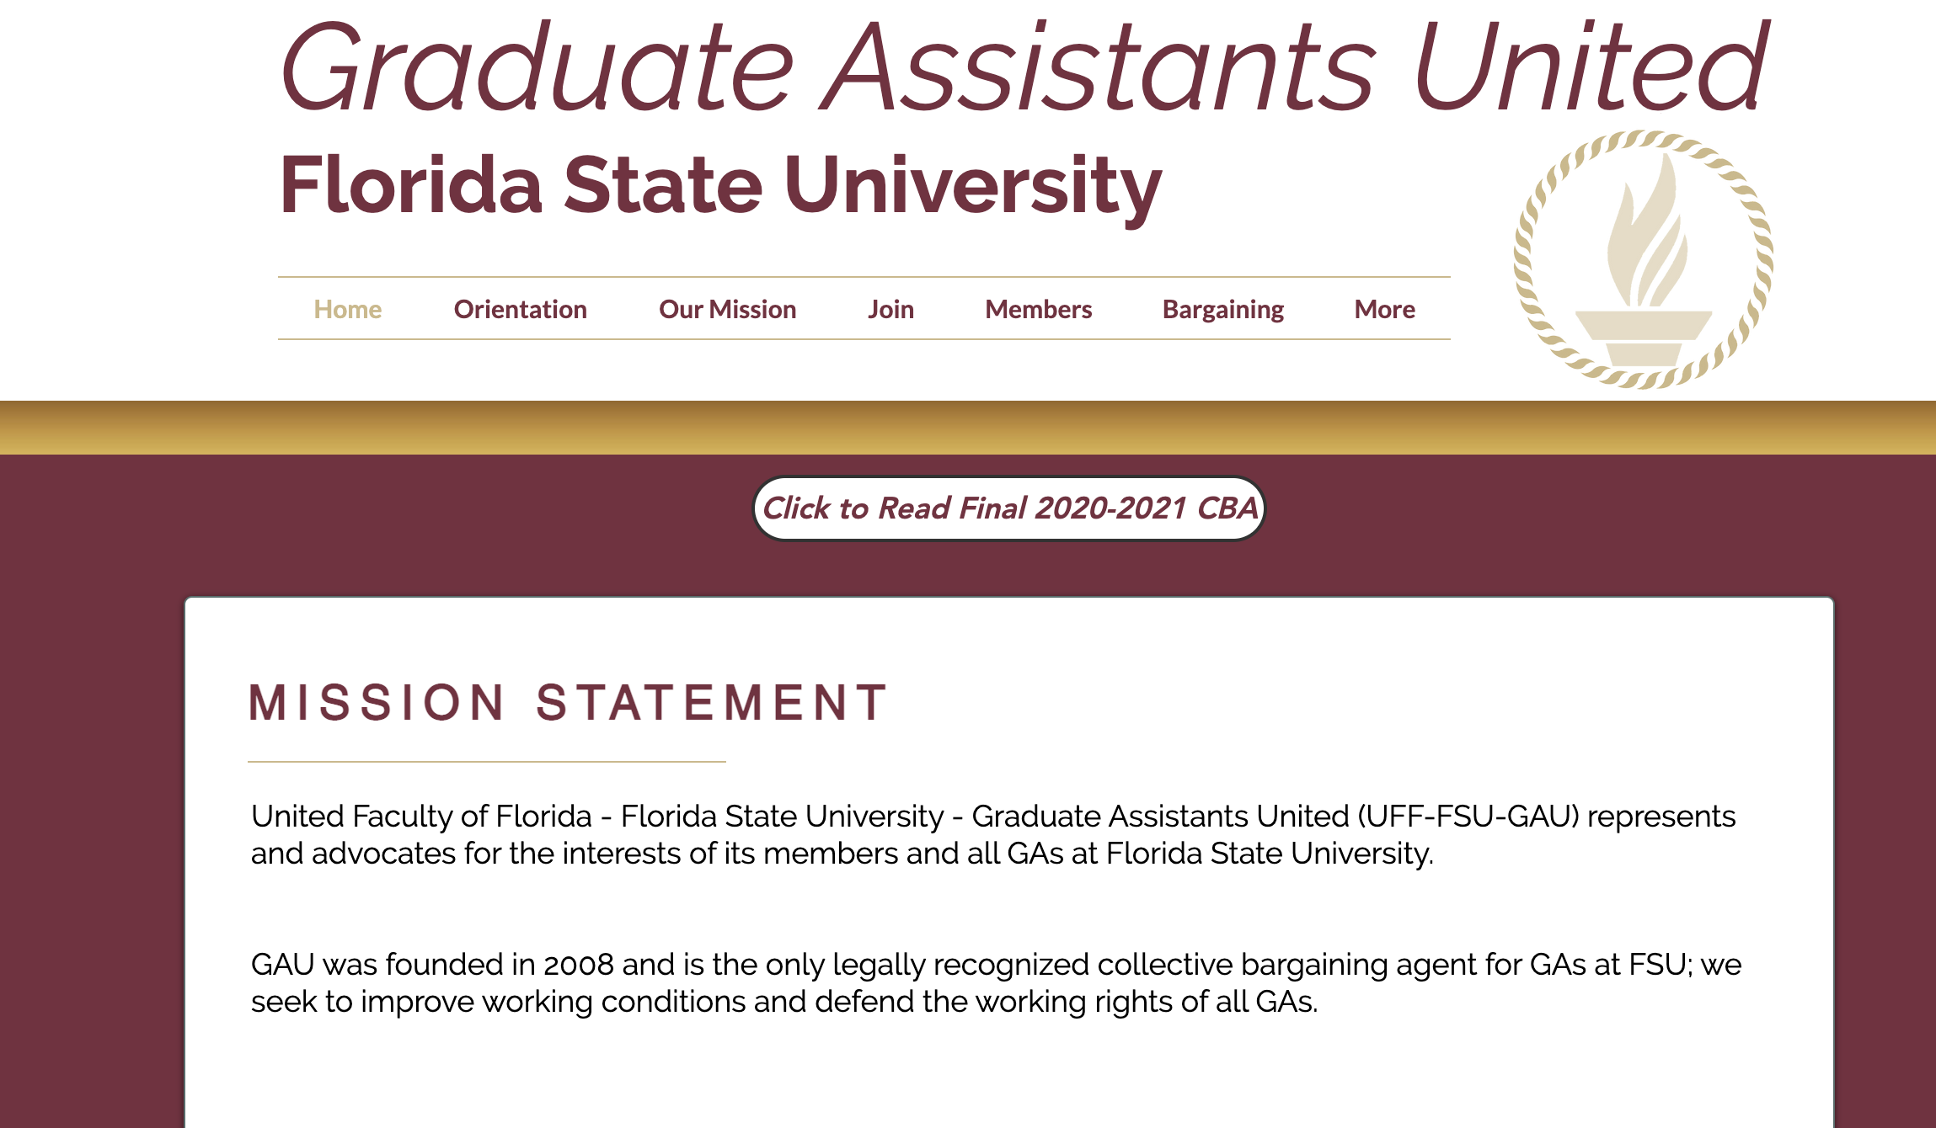
~600 members

Slide 4
Current Initiatives
Fees (ex. Tuition and fees)
GAs pay the university to do their jobs
Resolution to BOT
Legislation to waive fees
HB 553, SB 176
Bipartisan support in FL Leg
Fees: Financial aid fee (sec 7), Capital improvement trust fund (sec 8), activities and service health and athletic fee (sec 9), student health fee (sec 11), tech fee sec 13)
FSU Issue: Statute requires FSU to charge all graduate students
UF has gotten around this be reimburse
Leg Challenge: getting on the committee agendas in both house and senate. (Education and Appropriations)
Three years ago they got it through all committees and the senate president didn’t schedule it to be heard on the floor
Cost: $10-15 billion statewide
University is supportive of legislation as long as the State pays for it
Childcare
Not enough places for new kids admissions
Expansion helps
Don’t see this as an issue that affects grad students more than any other community
Misplaced assumption that the grad students don’t have families
15 spots reserved for GAs
How many people are they turning away?
University Budget
Proposed budget
End of year budget actually spent
Psych, english, Music, bio, chem
Send a survey

Slide 5
COGS Responsibilities
Chapter 101 Purpose of the Congress of Graduate Students
101.1 The Congress of Graduate Students, in accordance with Article IX of the Florida State University Student Body Constitution, shall:
A) Defend the interests of graduate, special, master, specialist, professional, doctoral, and post-baccalaureate students in graduate student life, services, and academics.
B) Manage the funds within its purview in a fiscally responsible manner.
C) Work to ensure the greatest participation by graduate students in the immediate governance of, and policy development for, the Florida State University.
D) Provide an official voice through which the opinions of the Graduate Student Body may be expressed.
*Only one of these four responsibilities involves funding*

Slide 6
Things that Stood out in COGS Code
Outdated Code:
104.7 Executive Editor
108.3
E) Committee leadership elections shall be held before February 19th, 2018 for any COGS Committee not existing prior to February 5th, 2018
F) On February 5th, 2018, the membership and leadership of the COGS committees listed here, shall be dissolved, at which point this provision 108.3(E) shall be stricken from the COGS Code: Internal Affairs Committee, Academics & Student Life Committee and Ways & Means Committee.
208.2 D) In the interests of fairness, the Speaker shall be authorized to permit a single $300.00 grant for students traveling to a conference over 300 miles from Tallahassee until June 30, 2011 at which point this provision 208.2(D) shall be stricken from the COGS Code.
Forgotten Roles:
108.5 Once a month the chairs if all standing committees (with the exception of the Budget Committee) shall meet with the Speaker to submit a written progress report, establish goals, and assign new members to committees.
112.1 The Deputy Speaker for Communication shall advertise vacancies within twenty-four (24) hours to the appropriate colleges in which the vacancies have occurred. In the case of vacancies in Advocacy seats, all colleges shall be informed. Vacancies shall also be forwarded to the SGA President’s Chief of Staff
211.2 Public Censure COGS may issue a public censure for RSOs or officers who engage in conduct that is either dishonest, unethical, or a violation of this code, if the Speaker and the Deputy Speaker for Finance concur.
300.7 3) LSC shall report to the Internal Affairs Committee of COGS as requested by the Internal Affairs Committee, with a minimum fifteen (15) school days’ notice.

Slide 7
Student Statutes “Purpose of COGS”
607.1 (B)
Purpose of COGS
1. To provide graduate and professional students at FSU, through COGS, an opportunity to participate in the decision-making process.
2. To consider, make recommendations and act upon phases of graduate/professional student life at FSU.
3. To serve as the principal forum for decisions on matters of broad concern to the graduate/ professional students at FSU.
4. To serve as the chief means by which graduate/professional students may express their university concerns for FSU-SGA.

Slide 8
Things that Stood Out in Student Statutes
607.1
(D) 2. COGS shall represent itself in Student Senate, either by a resolution read in Student Senate or by appearance of a delegate from COGS, on the following matters:
a. Legislation that changes Chapter 607 of the Student Body Statutes.
b. Legislation which is a resolution of COGS concerning university-wide matters.
c. Other matters as the SGA shall request COGS representation.
d. Other matters as COGS shall request to be represented before SGA.
J. Interaction Between COGS and SGA
1. A copy of all bills, minutes, and resolutions shall be sent promptly to COGS to SGA and vice versa. This task is the duty of the Information Officer of COGS and of the Student Senate Pro Tempore.
2. COGS and SGA representatives shall meet a minimum of twice a year to share and discuss issues, problems, and items of mutual concern. Each group shall host one liaison meeting each year.
3. Notification shall be given by the Student Senate Pro Tempore to COGS at the time of the first reading of bills originating in the Student Senate which change FSU Statutes, the Student Body Constitution, or any university-wide issues which affect COGS. A minimum of one week shall elapse between the first and second reading of the bill.
4. Legislation originated in Student Senate which would change Chapter 607 of the Student Body Statutes must pass the Student Senate by a two-thirds (2/3) majority vote. K. All provisions of Chapter 607 shall be considered fully severable.
(G.) 8. COGS will be offered a non-voting ex-officio seat on all Student Senate Budget Committees, budget sub committees, Central Reserves Committee, and Sweepings Committee.

Slide 9
No funding board shall allocate or fund any amount in the OCO category, absent Senate or COGS approval by resolution. This provision shall not be construed so as to prevent the Senate from doing so at any time.

Slide 10
Office of Governmental Affairs (see Legislation)
908.2 (A.) 2. The voting members will consist of the Student Body President or a designee, the Student Senate President or a designee, the Speaker of COGS or a designee, nine (9) members-at-large, the Director, the Deputy Director, and the Internal Assistant Director.
B. Powers and Duties of the Board
1. The Board shall set the legislative agenda for the student body for each legislative session. 2. The Board shall find affective means of educating the student body concerning voter turnout and voter registration.
3. The Board shall determine all of its rules and bylaws. The Board may recommend removal of the Director by a two-thirds (2/3) vote of the voting members. The Director shall not have a vote. Removal of any bureau officer shall occur only in accordance with Chapter 405 of the Student Body Statutes or by impeachment by the Student Senate.
4. Should the student body contract a private lobbyist service, the Board will produce any documents or proposals related to the procurement of such services.
5. The Board will plan and hold trainings and programs to educate and engage students about specific governmental/legislative issues, which are endorsed by student body legislative agenda or resolution passed by the Student Senate relating to government al relations and opportunities to get involved.
6. The Board will work to survey a diverse population of students to gain insight on concerns and opinions relevant to the mission of the office.

Slide 11
Office of Sustainability (no longer an active group?)
911.9 Ex-Officio Members
A. The following constitutes a list of students who may be included in the Green Leadership Circle as ex-officio members.
1. Student Body President or a designee
2. Student Senate President or a designee
3. COGS Speaker or a designee
Purpose
1.Coordinate and promote engagement sustainability within student-centered issues including, but not limited to conservation, social justice, and environmental service opportunities.
2. Educate students about pressing issues and current affairs related to sustainability through inclusive programming and reflection-based service experiences.
3. Recommend changes to the Student Government Association to promote a more sustainable Student Government Association and University.
4. The OSS shall serve as a collaborative organization, uniting several student groups around campus that maintain a focus on sustainability including conservation, social justice, environmental service opportunities, or any other fields that falls within these areas.

Slide 12
Rolls Outside of Statutes
The Speaker meets periodically with the Dean of the Graduate School and the University President.
The Speaker delivers speeches at University Graduation ceremonies, during Graduate School Orientation, and at the Fall SGA inauguration
Other Ex-officio seats on:
FSU University Survey Committee
FSU Child Development Programs, Board of Directors
FSU Graduate Enrollement Management Committee
FSU Student Technology Fee Advisory Committee
FSU Libraries Graduate Student Advisory Council
FSU Student Foundation, Board of Trustees

Slide 13
Messages from Previous Speaker (2015)
“It’s important to know these people and connect with them. The Senate President is elected at the first meeting of Senate following fall inauguration. The Student Body President is announced at the Senate meeting following spring elections and sworn-in at spring inauguration.
Have meetings with them at least once a month. You should have some idea of what’s going on in Senate and what the Executive Branch is working on. Graduate students often get overlooked because our experience can be so different from an undergraduate’s. You have to be a bit of a squeaky wheel.
Be aware of the platforms of any campus political parties. We don’t have parties in COGS, but it’s still important to know what the parties are doing. Sometimes you need to step in and speak for the benefit of graduate students to the majority party leadership – again, because there are very few graduate students involved elsewhere in SGA, undergrads don’t always have the benefit of understanding how their own policies might affect graduate students. It’s your job to make sure they gain that understanding.
Attend Senate when you can, especially when you have something to share about COGS projects or events. There is a line in the Senate agenda that is always reserved for messages from COGS,”

Slide 14
Other Notes
“On campus:
Pay attention to what’s happening on campus – social issues, political issues, administrative issues. You want to be aware when there are things going on that might affect graduate students. It’s up to you to be current on these issues so that you may inform Representatives. One of my goals with COGS was for us to have more of an official stance or voice on issues, made tangible by Resolutions voted on by the Assembly. We do more than just give RSOs money, we represent graduate students to campus and outside of FSU. Sometimes I think we did this well, and sometimes not. But it’s important to try.”

Slide 15
Current Legislation and Committess
https://sga.fsu.edu/2020-2021-PLATFORM.shtm
Funding medical bills or counseling for sexual assault victims
FSU Police Ride alongs
AEDs or CPR certified residence assistants for dormatories
Committee Appointments https://docs.google.com/spreadsheets/d/1NTi1ZDxCtya5xcy_ipekztSRLxAU5b7CYVLudWJOz1Y/edit#gid=822299471

Slide 17
Summary
Liaisons for the following:
Senate Meetings
Student Senate Budget Committees
Budget sub-committees
Central Reserves Committee
Sweepings Committee
FSU University Survey Committee
FSU Child Development Programs, Board of Directors
FSU Graduate Enrollement Management Committee
FSU Student Technology Fee Advisory Committee
FSU Libraries Graduate Student Advisory Council
FSU Student Foundation, Board of Trustees (removed?)
FSU Office of Governmental Affairs
Green Leadership group (inactive?)
Council of Presidents
Graduate Student Orientation
Graduate Assistants United
Advertising and filling seats
Updating COGS code to eliminate outdated code and add provisio language
Lots of money left in Senate projects (been asked for ideas, donations, etc.)
Budget statistics (help predict future needs)

