Slide 2
Agenda
COGS Overview
Intros
Budget Overview
Finances & Funding Boards
Representative Obligations
Committees
Wrap Up
Welcome!

Slide 3
What is COGS & What Do We Do?
The Congress of Graduate Students (COGS) is the official representative body of graduate students at Florida State University.
COGS is the part of student government dedicated to graduate students. COGS represents graduate student interests to the university and community and is empowered to issue resolutions expressing the views of graduate students and calling attention to important issues. The Congress provides graduate students with grants for conference travel, and funds programs and activities across campus that are targeted at graduate students. Additionally, the Congress is a funding source for graduate student organizations.

Slide 4
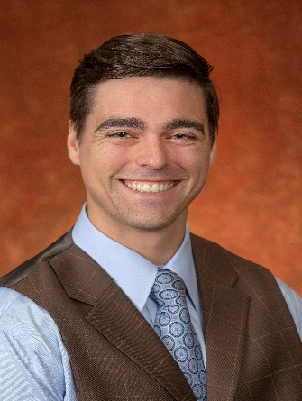
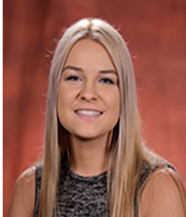
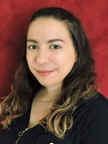
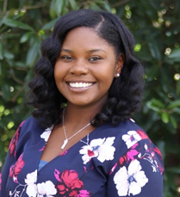
Meet the COGS Team
Michael J. Morgan
Speaker
COGSSpeaker@admin.fsu.edu
Caitlyn Blake-Hedges
Deputy Speaker, Finance
COGSDepSpeaker@admin.fsu.edu
Vacant
Deputy Speaker, Judicial Affairs
SGA-COGS-JA@fsu.edu
Tiffani Mendez
Deputy Speaker, Communications
SGA-COGS-Communications@fsu.edu
Jacalyn Butts
COGS Advisor
jbutts@fsu.edu

Slide 5
COGS 2020-2021 Budget
$580,000 Total Budget
$41,768.82 23 Budgeted Student Organizations
$65,000 Childcare Center
$12,000 Graduate School
$44,000 each, MSC & LSC
$190,000 COGS Grants (Presentation, Attendance, Dissertation, C-SAC)
$158,300 COGS Admin
$21,331.18 COGS Unallocated

Slide 6
Funding Boards:
Law School Council &
Medical Student Council
RSO’s will come in-person before each funding body to request an allocation for:
On-Campus Events
Group Travel
Promotional Items
etc.
LSC meets once per month and MSC meets twice per month to hear allocations from their respective College’s RSO’s*
LSC and MSC will maintain an allocation tracking excel sheet to ensure allocated funds are being spent and documents are submitted timely
In order to receives COGS funding Graduate RSOs must
be recognized through Student Orgs & Involvement
have at least two eligible officers complete & pass the financial certification exam through SGA Accounting, and
have submitted the SGA Statement of Understanding Authorized Signer Form to SGA Accounting prior to submitting a request

Slide 7
https://nolecentral.dsa.fsu.edu/
Deputy Speaker Blake-Hedges
Financial Certification Exam
COGS Code
Financial Manual & COGS Code is your best friend! ☺
_{Slide xof x}

Slide 8
Students
Graduate
Congress of
Questions to Ask RSO’s
General:
Has the group sought other funding sources?
Are the familiar with the services provided by Student Publications?
Event:
When is the event?
What is the purpose of the event?
Has the event occurred before? If so how did it go?
What is the expected attendance?
How will the group publicize the event?
Is the cost per person for food $8 or less?
Will there be a charge for admission
Purchasing items:
Are the vendors approved in the FSU System?
What is the cost per unit of t-shirts and promo items?
Will the items be given away as prizes?
Travel:
How was the opportunity to travel advertised?
How were students selected to travel?

Slide 9
Attendance Policy
If you cannot attend an assembly OR committee meeting or you will be late/leave early:
Send the Speaker (or Committee Chair) a message at least 1 hour before the meeting
You are allowed:
1 unexcused absence
3 total absences
…anything more and you will be up for probation/dismissal
Exceptions can be granted by majority vote of Executive Committee
Late/early dismissal:
Excused = 0.5 excused absence
Unexcused = 1 unexcused absence
FOR MORE INFORMATION
sga.fsu.edu/cogs.shtml

Slide 10
Attendance Policy
If you violate the attendance policy:
A review committee (Internal Affairs & Executive Committee) can suspend a member by a 2/3 vote
Suspended officers have 15 business days to appeal to the Assembly
Assembly can remove the representative
Rules regarding removal are not stated but will most likely follow impeachment proceedings (2/3 vote by Assembly)
FOR MORE INFORMATION
sga.fsu.edu/cogs.shtml

Slide 11
Legislation and You
Representatives will be the main points of contact for Graduate RSO’s seeking an allocation from COGS
Allocation Request Process:
Group Submits Allocation Request
COGS Speaker connects group and Representative (From Alphabetical list)
Group and Representative discuss the bill so that the Representative can present and answer question about the bill
Representative submits legislation to Speaker & Jacalyn by 5 PM on Thursdays before COGS Assembly meeting

Slide 12
Meeting Order
Review Internal Rules & COGS Code
Review Roberts Rules, Voting & Debate Measures (PAGE 16-18)
Motioning to Call the Question, Seconding, Objecting, Pros, Cons

Slide 13
Committees
Internal Affairs:
A) Prepare and distribute the monthly COGS newsletter
B) Keep website information updated
C) Outreach to fill vacant seats in the Assembly
D) Relations between COGS and the SGA, MSC, and LSC
E) Oversight all COGS funding expenditure
F) Train new COGS members
G) Make/Propose amendments to the COGS Code
H) Hear cases of impeachment and removal prior to the full Assembly
I) Maintain attendance records, and initiate removal proceedings for members who are no longer in compliance with attendance requirements
J) All other areas in which the Chair and the Speaker agree the committee should focus
Student Affairs:
A) Academics and Honor Policy
B) Parking and Transportation
C) Housing and Dining
D) Library
E) Health and Wellness
F) Social and Community Programming
G) All other areas in which the Chair and the Speaker agree
Student Advocacy:
A) Graduate student pay and funding
B) Childcare
C) Relations with the Graduate Assistants Union
D) Diversity on campus
E) Health Insurance
F) All other areas in which the Chair and the Speaker agree the
Committee Time: In your committees create 2-3 goals you would like to accomplish this fall semester
_{Slide xof x}

Slide 14
Important Dates
Financial Certification Exam: Open Now!
Next COGS Meeting: September 21st
SGA Elections October 7th
Extended Leadership Meetings: TBD

